Slide 1

Can Africa manage the return of Great Power Competition?
Edson Ziso, IRSK 2025
Exploring transformative regionalism for COMESA in an era of global re-ordering

Slide 2
With abundant natural resources, strategic chokepoints and a large population, combined with political instability, a challenging geography and limited finances, Africa is once again a critical arena for the competition between great powers for global dominance
“Geopolitical Shifts in Africa: Navigating the New World Order.”(Malcom, 2024).

Slide 3
Is it just GPC?
Great power competition on the continent is framed variously:
Great Powers jostling for influence in Africa is not new
A ‘New Cold War?’
A ‘New Scramble’? or
Is Africa simply getting more integrated into the global economy than ever before?
‘… contest between the ‘geopolitical West’ (including Japan and South Korea for example) and the emergent Eurasian ‘alteraxis’ with a China-Russian core’.

Slide 4
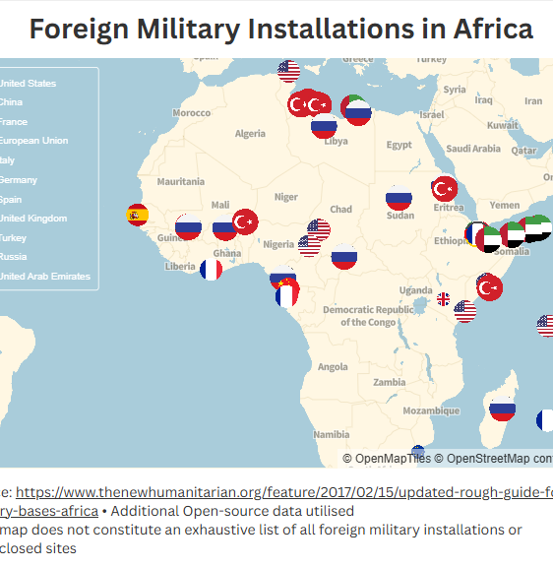
Great Power competition
Arenas
diplomatic
informational
military
economic (Critical minerals (cobalt, lithium, graphite, manganese…), supply chains, markets
influence-seeking
The return of spheres of influence

Slide 5
Context of GPC in Africa
Global re-reordering, an ever changing world
China’s foothold and growing dominance
The demise of a US-led Western global hegemony
Erosion of International law and global norms
Rising isolationism, nationalism
Multi-polarity
Declining multi-lateralism
Cuts to multilateral institutions (USAID), frozen development assistance
Diminished role for Africa in global decision-making forums
Alternative institutions e.g BRICS

Slide 6
Key protagonists
Different players, different interests
China
US
Russia
European Union
India
Brazil
Turkey
Gulf States

Slide 7
Can Africa win this time?
The challenge is how to leverage GPC for Africa’s benefit or win-win scenarios
GPC represents another threat but it can be an opportunity
Africa remains vulnerable for a variety of reasons
But what is required is strategy
Africa requires innovative diplomatic approaches to navigate GPC

Slide 8
Theoretical approach
Political economy: Normative constructivism in International Relations
complex interplay of power, economics, and diplomacy in the context of great power competition and regionalism
international law is a normative structure
Normative constructivism pays attention to ‘moral norms’ in world politics
shared ideas, identities, and norms, rather than solely material factors, shape the international system and state behaviour
International norms represent shared ideas, identities and norms - a reflection of the state of the world

Slide 9
Different modes of great power relations
An interrogation
US
Economic (AGOA is set to expire in 2025)
Diplomatic? (brokering peace deals, e.g Washington Accord (Rwanda & DRC)
China (primarily economic)
Belt & Road Initiative (since 2016)
strategic investments in infrastructure and natural resource projects
military and security cooperation minor, relative to US & China
European Union
Global Gateway (2021)
Countering China
Curbing migrant flows
Green industrialisation
Russia
Military - Strategic engagements, security cooperation agreements, Wagner mercenary group (Africa Corps)
Diplomatic (disinformation campaigns)
Undermining democracy and the rule of law

Slide 10
Strategic frameworks
Some Innovative diplomatic approaches
African agency (“Africa’s growing global influence, exemplified by achievements like G20 [Group of 20] membership, signals a continent ready to assert itself”, Carlos Lopes
Avoiding the zero-sum game
Exploit GP rivalry (the US and Soviet Union were played against each other during the CW, same can be done with the US and China today)
creative traditional and public diplomacy
Hedging
Bandwagoning
Avoid the “take-it-all” approach (Africa +1 summits)
Like-minded regionalism
Issue-based partnerships
Diaspora-led diplomacy

Slide 11
Expected outcomes
partnership diversification
Regional development
Regional integration
long-term strategies
Strategic autonomy
favourable trade agreements
industrial investments & tech advancements
Negative
Positive
Rising authoritarianism
Democratic backsliding, repression
Deals over diplomacy

Slide 12
Policy proposals
Africa should identify its strengths upon which it can leverage
Effective, pragmatic use of its talent
People-focused not elite-based agendas

