Slide 1
Competing Narratives and Conflict in Eastern DRC: Exploring Exclusion, Identity Politics, and Regional Security
DR. KIZITO SABALA
FRIDAH NJOKI

Slide 2



















Introduction: Conflict Background & Research Purpose
Conflict Background
Research Purpose
Eastern DRC conflict is a miniature of Great Lakes region's instability
This report analyzes competing narratives, exclusion phenomena, and overlooked perspectives in Eastern DRC conflict.
Characterized by competing narratives, multiple interpretations, and exclusion phenomena
Core Argument:
Different narratives, multiple interpretations, and exclusion largely explain why the conflict is difficult to resolve and manage.
M23 rebellion's rapid expansion (Feb-Mar 2025) reignited discussions about root causes
Research Questions:
Key Characteristics:
What competing narratives are misinterpreted, unexplored, or ignored in negotiation processes?
Complex and multi-faceted nature of the conflict
How these factors influence conflict resolution and management?
Different narratives compete for legitimacy
Exclusion and marginalization of certain groups

Slide 3














Key Theoretical Approach: Conflict Resolution Theory
Azar's Protracted Social Conflict (1985)
Galtung's Structural Violence (1990)
Seemingly unsolvable disputes where basic human needs based on community identity are deprived
Violence rooted in social structures; injustice and oppression cause harm by depriving resources
Emphasizes structural factors like underdevelopment and calls for responsive social institutions
Distinguishes between negative peace (no direct violence) and positive peace (no structural violence)
Complex, serious, persistent and often violent when communities cannot meet their needs
Human potential is a key indicator of positive peace and sustainable resolution
Burton's Human Needs Approach (1960)
Lederach's Conflict Transformation (1998)
Argue conflict is as a result of frustrated needs (which are non-negotiable).
A peace agreement stops violence through transformation of relationships and systems that cause the violence
Find a way to satisfy the fundamental needs of all parties. Analytical problem-solving, facilitated dialogue between influential parties.
It integrates short-term action with a long-term sustainable perspectives
Inherently long-term, aiming for a sustainable transformation of the relationship.

Slide 4


































Overview of Eastern DRC Conflict
Early Years (1960-1965)
Mobutu's Rule (1965-1971)
Cold War & Rwanda Impact
June 30, 1960: Independence
1965: Consolidated power
1980s: Cold War ending
July 4, 1960: Military coup
1971: Changed name to Zaire
Economic collapse
July 11, 1961: Katanga secession
1971: Authoritarian regime
1994: Rwanda genocide
January 1961: Lumumba's assassination
Economic mismanagement
Millions of Hutu refugees
First Congo War (1996-1997)
Second Congo War (1998-2003)
Recent History (2013-2025)
Rwanda's disguised invasion
Rebels targeting Kabila
2013: Lusaka Peace Agreement
Bania-Mulenge and AFDL rebellion
Multiple regional powers involved
2013: M23 rebellion (Tutsi-led)
Overthrew Mobutu
3.2-4.2 million deaths
2025: M23 violence and occupation
Laurent Kabila in power
Large-scale displacement
International intervention

Slide 5


























Competing Narrative 1: Marginalization and Exclusion
Marginalization & Exclusion
Rwandan-origin Congolese Communities
Systematic exclusion from political power and economic opportunities creates conditions for conflict.
The experience of Rwandan-origin Congolese illustrates exclusion politics:
Migration Waves
Citizenship Issues
Identity Politics
First Generation (18-19th centuries)
Deprivation of citizenship rights
Groups defined by ethnicity
Banyamulenge Tutsi pastoralists
Land Disputes
Economic Marginalization
Colonial Period (1910s)
Insecure land ownership
Denial of resources
Boundaries separated communities
Subsequent Waves (1937, 1959-64)
Tutsi and Hutu labor migration
Impact on Conflict
Post-1994 Genocide
Hutu refugees including ex-FAR
Rebel Mobilization:Excluded groups join armed groups promising protection
Current Exclusion
1995 parliamentary resolution stripped citizenship
Failed Peace:Exclusionary agreements fail to address root causes
Viewed as "foreigners" despite generations in Congo
Cyclical Violence:Creates self-reinforcing patterns of conflict
"M23 and other rebels mobilize around these grievances, claiming to protect their communities."

Slide 6









Competing Narrative 2: Colonial Legacy
Colonial Legacy Timeline
Continuing Impact
1884 Berlin Conference
Boundary Legacies
Colonial boundaries drawn affecting Tutsi and Hutu populations
Boundaries created during colonial era continue to divide communities
1910s Belgian Policies
Institutional Weaknesses
Colonial policies led to severe talent shortage after independence
Redrawing rural boundaries and institutionalizing ethnic identity
Exclusionary Structures
1964 OAU Resolution
Power structures favoring certain ethnic groups persist
"Uti possidetis principle" adopted to prevent post-colonial conflicts
Economic Disparities
Colonial resource extraction patterns continue to affect land disputes
1960 Independence
State collapse due to talent shortage and institutional weaknesses
These roots continue to manifest in the current security landscape.

Slide 7






















Competing Narrative 3: Governance and Administrative Deficits
Post-colonial Congo has struggled with governance challenges that have contributed to its persistent conflict.
Governance Challenges
Military Indiscipline
Predatory State
State unable to govern vast territory effectively
Army initially designed for colonial policy implementation
State characterized as predatory rather than absent
Weak institutions created power vacuums
Post-1960 military reform never materialized
Officials deliberately destroy military and administration
Failure to provide security and basic services
Culture of impunity for human rights abusers
International capacity-building efforts may strengthen corruption
"Military has become a disciplined force that intimidates civilians rather than protecting borders."
"The Congo state is not absent but predatory, with weaknesses deliberately maintained to profit from chaos."
"International security sector reform may unintentionally strengthen predatory networks."
These governance failures create a self-sustaining cycle of conflict and impunity.

Slide 8







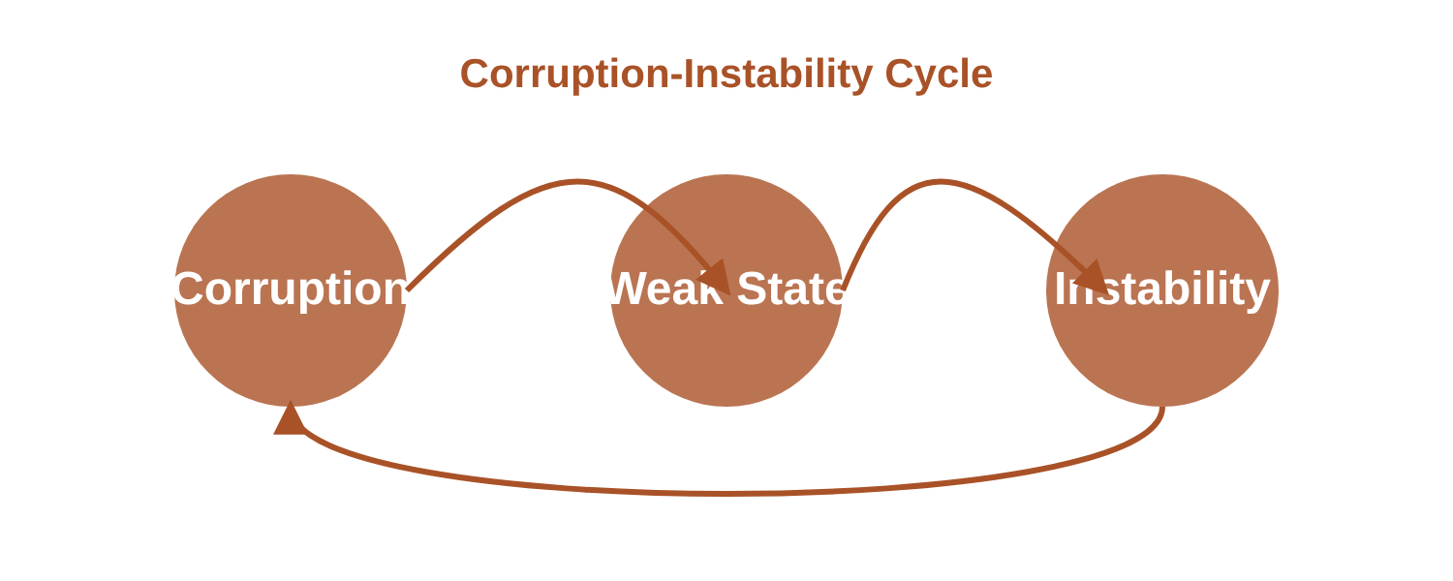






Competing Narrative 4: Corruption as a System
Systemic Corruption
Case Studies
DRC ranks low on global corruption indices
La Générale des Carrières et des Mines
Natural resources exist but people remain among poorest globally
State mining company lost billions through transactions with international companies
Extractive industries (mining, oil) particularly corrupted
Wealth becomes a cash tree for elites rather than development
Middle Layer Corruption
Systematic underweighting of mineral-laden trucks
"Looting" Culture
Those in power looting during crisis: 1991 ‘pillage’ by soldiers
How Corruption Perpetuates Conflict
Weakens military's ability to provide security
Undermines judicial system's ability to uphold justice
Erodes government legitimacy among citizens
Prioritizes personal loyalty over capability and public service
Creates self-sustaining cycle of violence and instability

Slide 9















Competing Narrative 5: Land, Rent, Power & Rwanda Connection
Land & Resources Struggle
Rwanda's Post-Genocide Influence
Key Events & Consequences
M23, primarily Tutsi-led, fights for control over land and mineral resources in Eastern DRC
1996-1997:First Congo War, influenced by Rwandan genocide
1994 genocide created massive refugee flows into Eastern DRC
Rich mineral deposits in the region make control over territories highly valuable
1998-2003:Second Congo War with regional powers
Thousands of Hutus fled to Congo to avoid Tutsi revenge attacks
Large refugee populations, mainly Hutu, have increased competition for limited resources
2013:M23 rebellion rises, claiming to protect Tutsi communities
Rwanda supports M23 rebellion as a proxy to maintain influence in the region
Power imbalances between different ethnic groups and communities
2025:M23 resurgence and capture of strategic cities
Creates complex web of ethnic allegiances and power relationships

Slide 10














Competing Narrative 6: Regional Security Concerns
Overview
Neighboring Countries' Involvement
The Great Lakes region faces complex, highly insecure peace and security environment, especially in Eastern DRC
DRC
Rwanda
Burundi
Uganda
Angola
Foreign armed groups like FDLR, ADF, and FNL continue operating in DRC territory
Regional Security Dynamics:
Political security competition among small Great Lakes countries (DRC, Rwanda, Burundi, Uganda) is inseparable
Key Examples:
Characterized by historical enmity, constantly changing alliances, and proxy wars
FLNC (Mobutu era):Used Angola as base and launched invasions
FDLR (post-genocide):Hutu militias established safe havens in Eastern DRC
International debates often focus on Rwanda's security concerns while ignoring DRC's own deep security concerns
Uganda & Burundi:ADF, LRA, and FNL operated in Eastern DRC
These groups' continued existence has destabilized the entire Great Lakes region and often led to direct or indirect involvement from neighboring countries.

Slide 11
















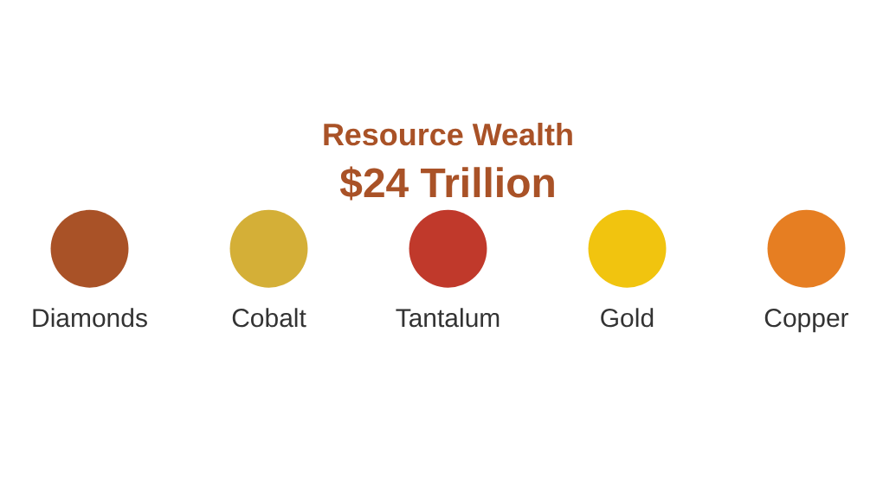


Competing Narrative 7: Resource Curse and External Interference
Resource Wealth
Exploitation Patterns
External Interference
Estimated $24 trillion in mineral wealth
Colonial Legacy
Neighboring Countries
Leopold II's rule and Belgian colonialism established system of unlimited exploitation through forced labor
Zimbabwe, Angola, Namibia have foreign troops; Rwanda, Uganda, Burundi support rebel groups
Largest country in Sub-Saharan Africa
Rich in rainforests and biodiversity
Major global cobalt and tantalum producer
Western Powers
Mobutu's Rule
US intervention in internal affairs, prioritizing mineral wealth for tech and AI innovation
Fourth-largest diamond producer globally
Country treated as personal property, wealth输送 to clients
UN Peacekeeping
Contemporary Exploitation
International troops on the ground, but with limited impact on resource exploitation
Internal, regional and external actors compete for DRC's resources
"Internal instability exacerbates regional geo-political power struggles and proxy wars"

Slide 12






Impact on Conflict Resolution: Marginalization and Exclusion
Marginalization as a Core Cause
Marginalization and exclusion arenot side effectsbutcore driversof the conflict in Eastern DRC.
Recruitment Vulnerability
Failed Peace Agreements
Communities excluded from political power and economic opportunities are vulnerable to recruitment by armed groups that promise protection, income, and revenge.
Peace agreements that only include state elites and armed group leaders (bought through government positions) will fail to address the root causes of violence cycles.

Slide 13















Impact on Conflict Resolution: Colonial Legacy and Identity Politics
Colonial Legacy
Identity Politics
Political Exploitation
Borders drawn during Berlin Conference (1884)
Identities viewed as fixed and historical
Powerful elites manipulate identity
maintains
enables
Resources diverted to favored groups
"Actual occupation principle" (1964)
Political manipulation of citizenship
Belgian policies intensified ethnic tensions
Elite control over identity narratives
Exclusion from political processes
Impact on Conflict Resolution
Obstructing Factors
Way Forward
Colonial boundaries continue to separate Rwandan communities, preventing resolution of land disputes
Address structural causes rather than just managing symptoms
Dialogue that acknowledges historical context and addresses identity concerns
Identities are manipulated to exclude certain groups from citizenship and resources
Justice mechanisms that address colonial-era wrongs
Structural violence creates conditions where conflict is seen as normal

Slide 14


















Impact on Conflict Resolution: Corruption and Regional Security
Corruption as Political Economy "Operating System"
Misinterpreted Regional Security Concerns
Corruption is not just a cultural issue but a political economic system that:
Both Congo and Rwanda have legitimate security concerns:
Congo's Concerns
Rwanda's Concerns
Concentrates wealth and power in state and transnational elites
Worries about Rwanda's aggression and support for rebels
Worries about FDLR armed groups and genocide perpetrators
Is an accepted feature of economic activity
International debates often focus on Rwanda's concerns while ignoring Congo's legitimate concerns
Systemic reform efforts are systematically undermined
Impact on Peace Efforts
How Corruption Undermines Peace
"This misreading of security concerns has paralyzed peace efforts in the Great Lakes region"
Weakens state institutions
Enriches elites
Fuels conflict

Slide 15













Conclusion and Recommendations
Key Conclusions
Different narratives, multiple interpretations, and exclusion largely explain why the conflict is difficult to resolve
Marginalization creates conditions where communities are vulnerable to recruitment by armed groups
Colonial legacy and identity politics continue to fuel the conflict
Corruption as a system perpetuates the cycle of violence and instability
Recommendations for More Inclusive Approaches
Addressing Exclusion
Systemic Challenges
Historically Informed Approaches
Regional Security Dialogue
Acknowledge colonial legacies and identity politics in peace processes
Address concerns of neighboring countries while ensuring transparency
Inclusive Governance
Anti-Corruption Measures
Ensure participation of marginalized groups in political processes
Implement transparency and accountability in resource management
"Peace in Eastern DRC requires addressing both the symptoms and root causes of conflict, while ensuring inclusive participation of all affected communities."

Slide 16
END

