Slide 1




IRSK Annual Conference 2025
Resilience Amid Rising Disorder
Rethinking Regional Peace Architectures in the COMESA Bloc
By Singo Mwachofi & Barrack Ogada

Slide 2
Agenda: Rethinking Regional Peace Architectures
This presentation will cover critical topics regarding COMESA's security challenges and resilience strategies.
Hybrid threats facing the COMESA region today
Limitations of the current security framework in COMESA
Exploring realism and constructivism as theoretical lenses
Enhancing institutional resilience through effective mechanisms and strategies
Human security issues affecting the COMESA member states
2

Slide 3
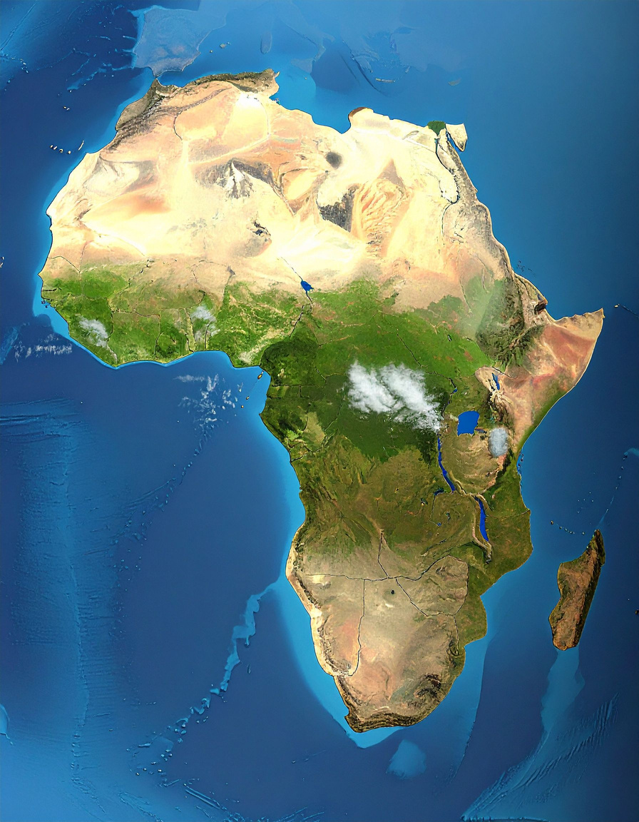
Current Security Framework Limitations
  Over-reliance on the state-centric model
  Fragile institutions are unable to sustain peace
  Exclusion and marginalization fuel recurring violence
  Overlaps with IGAD, SADC, and AU dilute focus
  Weak operational capacity in crisis situations
  Policy commitments often outpace practical delivery
3

Slide 4
Theoretical Lens
Realism: States prioritize sovereignty, power, and security
  Security dilemma fosters mistrust and fragmented cooperation
  Larger states dominate smaller ones (Egypt, Kenya vs. Comoros, Burundi)
Constructivism: Norms, trust, and identities shape security cooperation
  COMESA reflects the African principle of “African solutions to African problems”
  Resistance to supranational authority slows norm diffusion
4

Slide 5

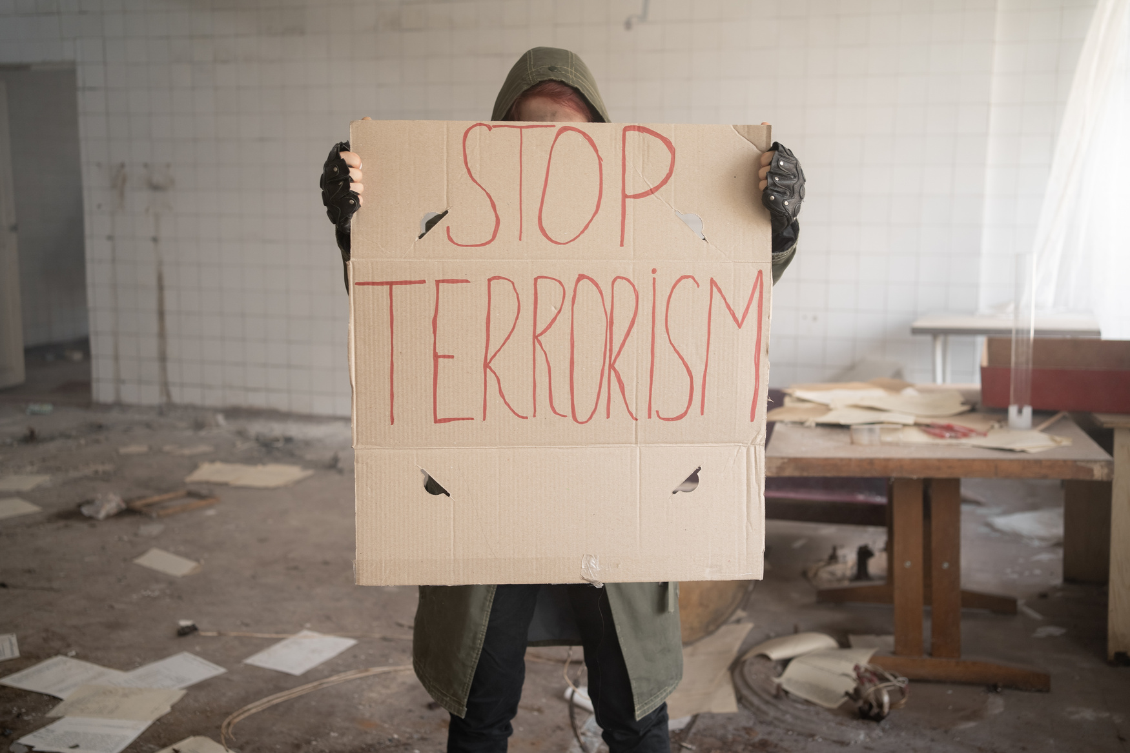

Hybrid Threats
Terrorism
Cyber-attacks
Organized Crime
Terrorism poses a significant threat to regional stability and security.
Cyber-attacks target critical infrastructure, threatening economic resilience and safety.
Organized crime undermines governance and fuels corruption in societies.
5

Slide 6
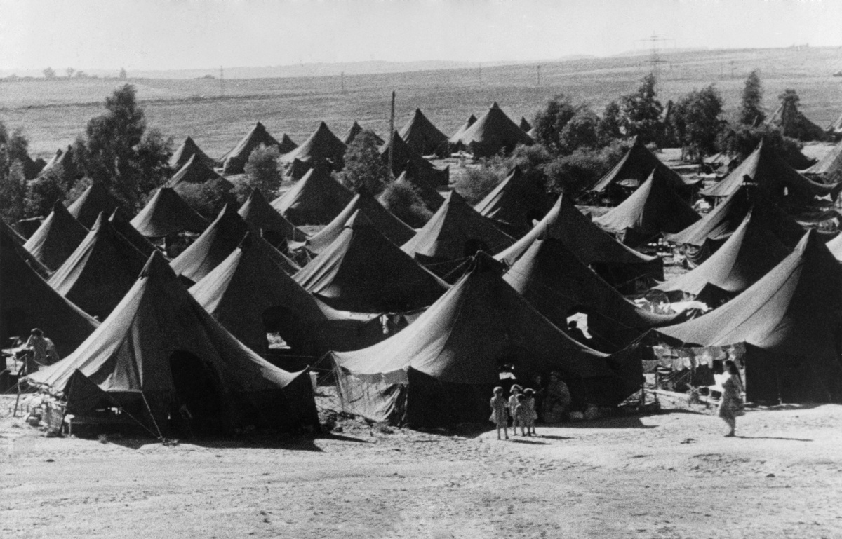


Human Security
Displacement
Food Insecurity
GBV
  Shifts focus from states to communities and individuals
  Defined by freedom from fear, want, and indignity (UNDP 1994)
  Conflict-affected communities are most vulnerable
  Prioritizes dignity, livelihoods, and protection of civilians
  Critical to sustainable and inclusive peacebuilding
6

Slide 7
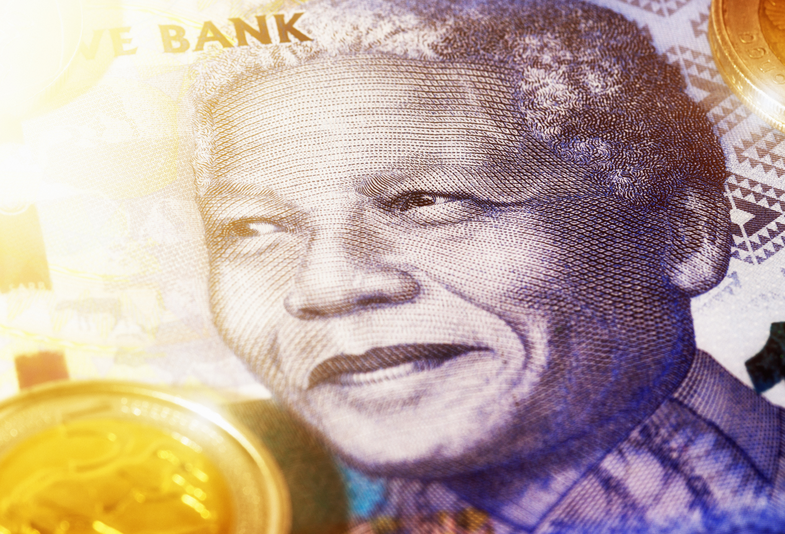
Enhancing Institutional Resilience
Key mechanisms supporting regional peace and stability
CEWARN (Early Warning)
Committee of Elders (Mediation)
  Monitoring conflict indicators
  Timely information dissemination
  Engaging local communities
  Mandate for peaceful conflict resolution
  Structured mediation processes
  Active community engagement
7

Slide 8
Examining the Role of Regional Trade Corridors in Fostering Peace
Regional trade corridors can significantly enhance economic stability and promote peace among COMESA member states.
By improving connectivity and facilitating trade, these corridors create interdependence that may help mitigate conflicts and foster collaboration in addressing shared challenges within the region.
8

Slide 9
COMESA Peace & Security Architecture Overview
  Founded in 1994 from the Preferential Trade Area framework
  21 member states, 560+ million people, GDP $768B
  Conflict Early Warning and Response Mechanism (CEWARN)
  Committee of Elders for preventive diplomacy
  Gender and Social Affairs Division mainstreams inclusivity
  Economic integration tied to the peace and stability vision

Slide 10
Treaty Provisions Overview
  Article 3(d): peace, security, stability essential for integration
  Article 124: peace as a foundation for growth
  Article 125: cooperation against terrorism & transnational crime
  Article 126: conflict prevention, management, and resolution framework
  Provisions align COMESA with the AU Peace and Security Architecture
  Anchors COMESA as both an economic and peacebuilding REC
10

Slide 11
Achievements
  Trained mediators and civil society in conflict prevention
  CEWARN improved risk analysis and election monitoring
  Committee of Elders engaged in discreet preventive diplomacy
  Women’s networks supported through COMFWB
  Integrated gender in security frameworks
  Reinforced AU and SADC peace efforts
11

Slide 12
Limitations
  Overdependence on donor funding undermines ownership
  Overlaps with IGAD and SADC create duplication
  Reliance on state inputs limits early warning effectiveness
  Weak enforcement due to sovereignty sensitivities
  Political will is lacking for timely interventions
  Visibility of COMESA interventions remains low

Slide 13
Contemporary Security Challenges
  Rising transnational crime (arms, trafficking, resource smuggling)
  Climate change intensifies communal and cross-border conflicts
  Terrorist groups tied to illicit financing networks
  Porous borders enable the free movement of armed groups
  Weak state institutions create governance vacuums
  Unequal development fosters resentment and radicalization

Slide 14
Case Study – Eastern DRC
  Over 120 armed groups linked to mineral wealth and ethnic divides
  Conflicts spill into Uganda, Rwanda, and Burundi
  ADF and FDLR destabilise the entire Great Lakes region
  Smuggling networks finance violence via illicit trade routes
  COMESA is limited to data collection and dialogue forums
  Interventions overshadowed by ICGLR, AU, SADC

Slide 15
Case Study – Cabo Delgado (Mozambique)
  Islamist insurgency since 2017: poverty, marginalization, illicit trade drivers
  Nearly 1M displaced and 4,000+ killed by 2022
  LNG projects disrupted, threatening regional economies
  Insurgents linked to global extremist networks
  SADC and Rwanda led interventions, not COMESA
  Lack of rapid deployment highlights institutional gaps

Slide 16
Case Study – Horn of Africa
  Conflicts: Tigray (Ethiopia), Sudan civil war, Eritrea border tensions
  Al-Shabaab attacks destabilize Kenya and Uganda
  Drought-induced famine displaces millions
  IGAD dominates peace mediation in the region
  COMESA is limited to trade-related peace initiatives
  Overlaps with other RECs dilute COMESA’s role

Slide 17
Gaps Between Policy & Practice
  Ambitious treaties vs. weak practical implementation
  Preventive diplomacy limited to elite-driven initiatives
  Gender mainstreaming is underfunded and marginalized
  Local communities excluded from decision-making
  Donor reliance creates shifting priorities
  Institutions slow to adapt to hybrid threats

Slide 18
Paradigm Shift – Towards Human Security
  Move beyond sovereignty-focused security to people-centred models
  Empower local peace infrastructures and community leaders
  Prioritize governance reforms: decentralization, accountability, inclusion
  Strengthen women’s and youth participation in peacebuilding
  Build trust through community–government collaboration
  Align COMESA security with AU Agenda 2063 and UN SDGs

Slide 19
Peace Resilience Compact (PRC)
  Regionally owned framework under Article 3(d)
  Principles: human security, local ownership, inclusivity
  Conflict-sensitive trade corridors as peace dividends
  Fusion centers for intelligence and early warning
  Cross-border cooperation and joint development zones
  Embeds peacebuilding in economic and governance strategies

Slide 20
Conclusion
  COMESA has strong frameworks but weak implementation
  Hybrid threats demand adaptability and inclusion
  Human security must complement state security
  Local peace structures, women, and youth are central to solutions
  PRC offers a holistic, sustainable peace model
  Path forward: shared prosperity, resilience, and regional trust

Slide 21

Presented by: Singo Mwachofi & Barrack Ogada

