Slide 1

Weaponized Dependencies:
Effect of the Russia–Ukraine War on Food Insecurity and Peacebuilding Efforts in Africa
By: Fatuma Sarah
Adjunct Lecturer at Riara University
PhD Candidate at USIU-Africa
Contact: fatuumasarah@gmail.com | fsarah@riarauniversity.ac.ke
IRSK Annual Conference 2025

Slide 2
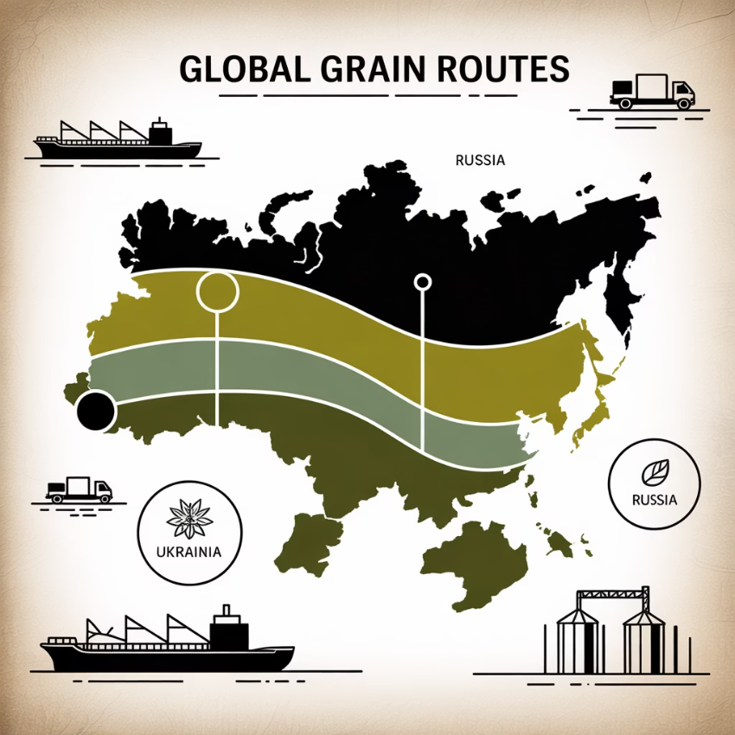
The Global Food Crisis Unfolds
Russia's invasion of Ukraine in February 2022 continues to reverberate through global food supply chains, creating cascading effects that extend far beyond the immediate conflict zone. These two nations collectively account for nearly 30 percent of global wheat exports and over 50 percent of sunflower oil exports, establishing them as critical exporters in the world's agricultural infrastructure.
Africa bears a disproportionate burden of this disruption, with the continent importing more than 40% of its wheat from Russia and Ukraine. This structural dependence exposes a fundamental vulnerability in Africa's food security architecture, revealing what this study terms "weaponized dependencies" – the deep reliance on external food supplies that can be disrupted by geopolitical shocks.
This research examines how disrupted grain imports, soaring food prices, and agricultural inflation impact peace and stability across Africa, with particular focus on fragile and conflict-affected states through the lens of Ethiopia's experience.

Slide 3

Ethiopia: A Critical Case Study
Economic Profile
Agricultural Significance
GDP: ~$156 billion (2023) (World Bank, 2024),
Population: >120 million
Second-most populous African nation
One of Africa's most agriculturally important economies80% of population dependent on agriculture
Vulnerability Factors
Prolonged internal conflictClimate-driven droughtHeavy wheat import dependence
Ethiopia exemplifies the intersection of global market disruptions and domestic fragility. Despite growing research on the Russia-Ukraine war's impact on global food security, the specific lens of weaponized dependency and its effects on peacebuilding efforts remains critically understudied. This analysis draws from comprehensive secondary data including FAO, WFP, and AfDB reports to understand how international food dependencies contribute to national vulnerabilities during geopolitical crises.

Slide 4
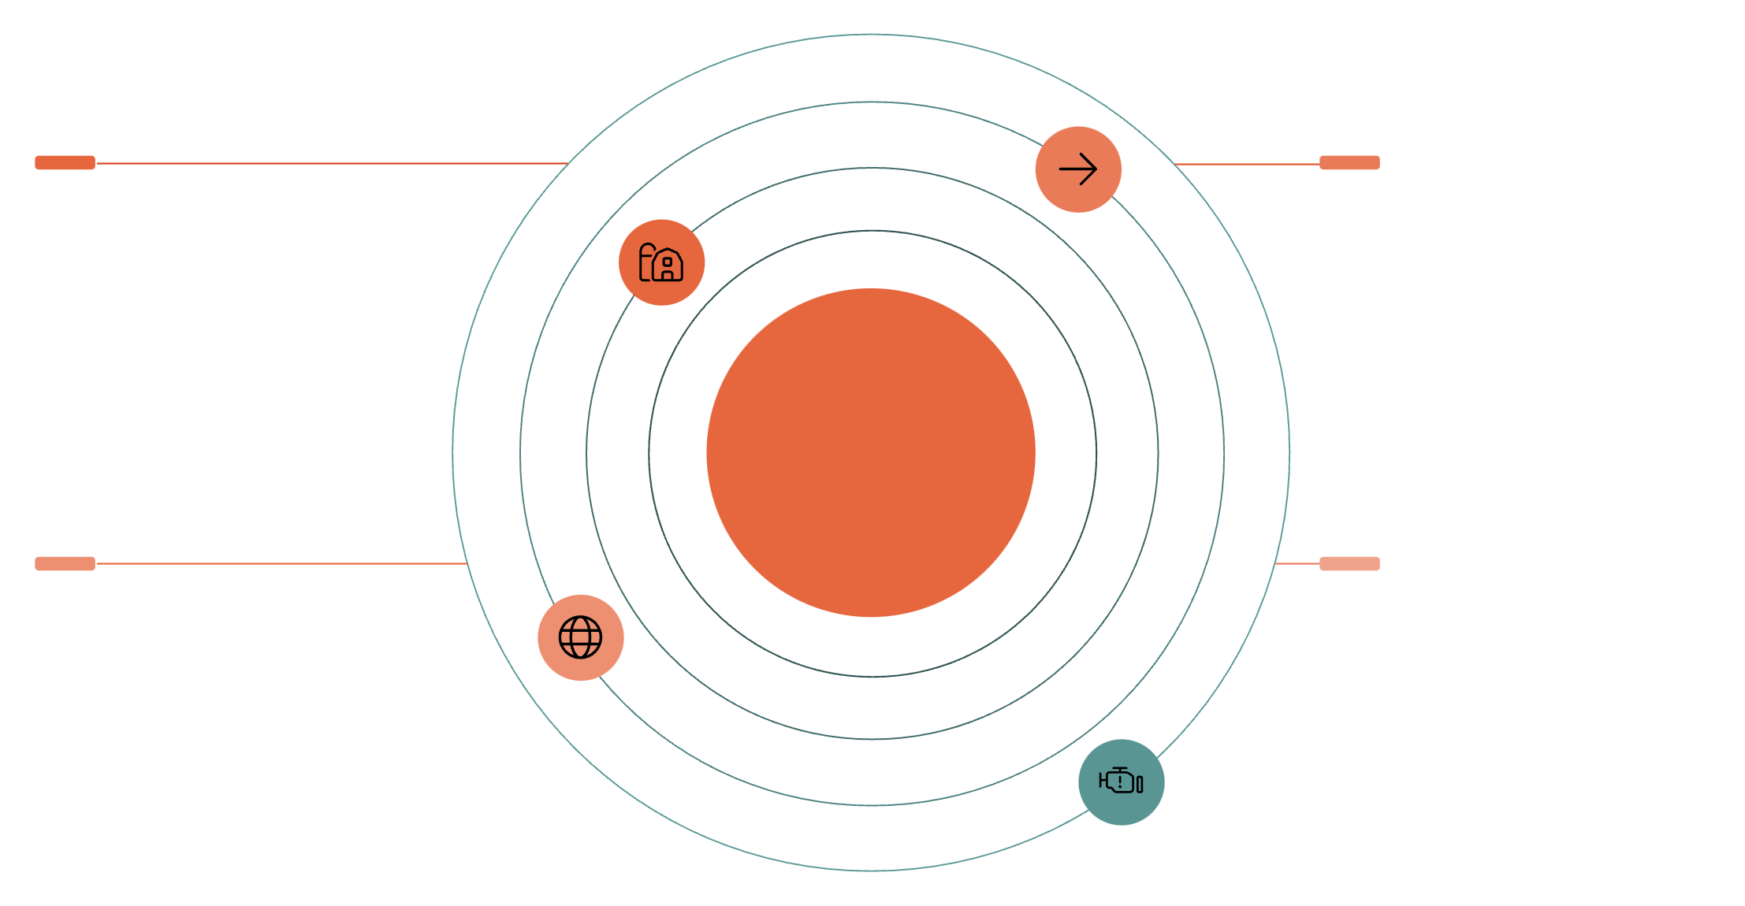





Theoretical Framework: Dependency Theory
Peripheral States
Resource Flow
Export raw agricultural inputs and labor
Capital and commodities move to core economies
Core–Periphery Resource Dynamics
Core States
Systemic Vulnerability
Accumulate wealth in Russia and Ukraine
Local food insecurity and dependency rise
This study's theoretical foundation rests on Dependency Theory, which provides a robust framework for understanding the structural vulnerabilities of peripheral economies within the global system. The theory demonstrates how resources flow from periphery states to enrich core states, perpetuating underdevelopment and maintaining asymmetrical power relations.
Weaponized Dependencies: Strategic reliance on external food supplies that leaves nations exposed to exploitation or unintended harm during geopolitical crises, threatening food sovereignty and policy autonomy.
In the modern global food system, this manifests as weaponized dependencies where strategic reliance on external food supplies exposes nations to exploitation during crises. Such dependencies erode food sovereignty, reduce policy autonomy, and exacerbate vulnerabilities that threaten economic stability and national security.

Slide 5
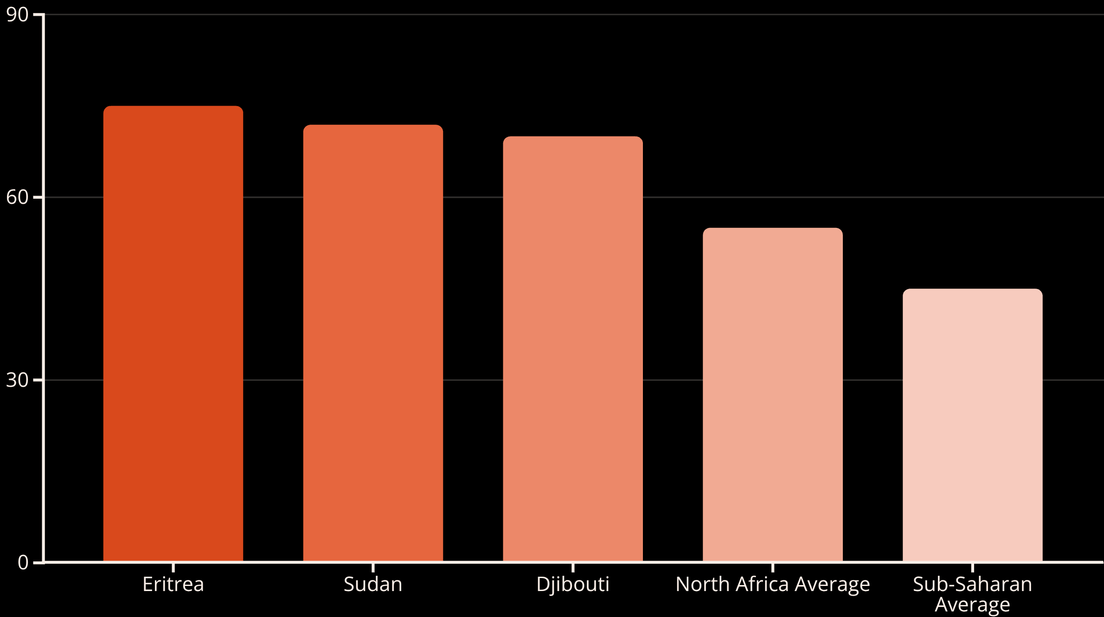
Literature Review: Continental Vulnerabilities
Comparative research across Middle Eastern, North African, and sub-Saharan African states reveals widespread vulnerabilities among import-dependent nations. Before the war's outbreak, fifteen African countries imported more than half their wheat from Russia and Ukraine, with countries like Eritrea, Sudan, and Djibouti exceeding 70 percent dependency levels.
Case studies demonstrate that conflict-driven fertilizer price increases led to declining agricultural productivity throughout North Africa. This evidence underscores the urgent need to re-evaluate Africa's structural dependencies in agricultural trade and explore measures to enhance resilience against conflict-induced volatility.

Slide 6



Climate as a Risk Multiplier
Climate Variability
Agricultural Vulnerability
Conflict Escalation
Frequent droughts, heat extremes, erratic rainfall, and flooding across Africa
Heightened pre-existing vulnerabilities in climate-sensitive agrarian economies
Increased food insecurity and conflict risks, particularly in fragile contexts
Climate variability serves as a critical risk multiplier, amplifying existing vulnerabilities in agrarian economies and increasing both food insecurity and conflict risks. Extensive empirical literature links rainfall and temperature deviations to heightened social upheaval, communal tension, and civil unrest across Africa, particularly where livelihoods depend on climate-sensitive agriculture and state institutions lack adequate shock-buffering capacity.
The literature establishes a clear nexus between food insecurity and conflict, revealing these as mutually reinforcing phenomena operating through interconnected pathways at household, market, and governance levels.

Slide 7

Methodology: Analytical Approach
Research Design
Analytical Framework
This study employs a qualitative research design utilizing comprehensive secondary data sources from major international institutions including the Food and Agriculture Organization (FAO), World Food Programme (WFP), and African Development Bank (AfDB).
01
Content Analysis
Systematic review of Ethiopia's grain import dependence and price shock responses through policy briefs and annual reports
02
Data Triangulation
Enhanced credibility through multiple source verification (FAO economic data vs. ACLED conflict records)
The methodology combines qualitative content analysis with triangulation techniques to ensure robust findings. Content analysis examines Ethiopia's import dependencies and crisis responses, while triangulation validates findings across multiple data types and institutional sources.

Slide 8




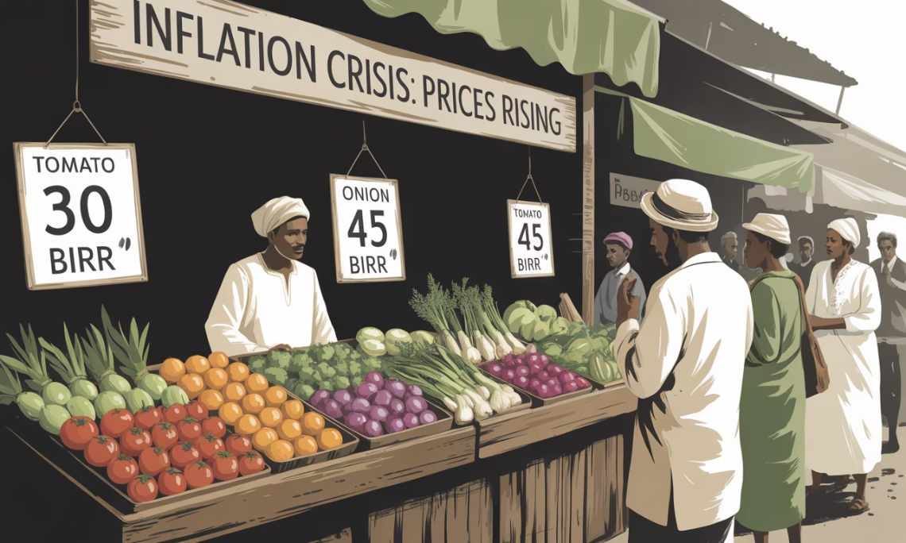
Food Insecurity Crisis in Ethiopia
50%
100%
Sunflower Oil Prices
Wheat Price Increase
Sunflower oil prices nearly doubled, creating severe market volatility
Domestic wheat prices surged by 50% following the conflict outbreak
38%
Ethiopia experienced severe food security deterioration as a direct consequence of its dependence on Russian and Ukrainian agricultural exports. The conflict triggered a 50% increase in domestic wheat prices while sunflower oil costs nearly doubled, demonstrating how international military conflicts can spark immediate economic turbulence within already fragile states.
Food Insecurity Rate
Overall, food insecurity increased by 38%, compounded by internal Tigray conflict
Food price inflation reached 34% compared to the previous year, creating additional strain on vulnerable populations already suffering from the internal Tigray conflict. This represents not merely a global trade shock, but a destabilization of existing in-country vulnerabilities that Ethiopia was already confronting across multiple dimensions.

Slide 9

Agricultural Input Crisis: Fertilizer Shortage
The Russia-Ukraine conflict precipitated an unprecedented fertilizer shortage in Ethiopia, given that Russia and Belarus supply most of the world's fertilizers. War-related supply route destruction and sanctions created global availability shortages and dramatic price increases.
11%
30%
Import Reduction
Demand Shortfall
Ethiopia imported 11% less fertilizer than previous years (Gejea & Tolesa,2024),
Shortfall of 30% from expected national fertilizer demand
According to FAO projections, fertilizer shortages directly impacted staple crop production potential, with anticipated yield losses of 5.4% for maize, 3.8% for wheat, and 3.2% for teff – crops that form the foundation of Ethiopian food security and agricultural livelihoods.

Slide 10








Compounding Agricultural Vulnerabilities
Agriculture serves as the primary source of rural employment and livelihood, accounting for 80% of jobs in Ethiopia, making yield declines far more than sectoral concerns. The fertilizer scarcity challenge intertwined dangerously with climatic variability, as Ethiopia faced extended drought periods during 2022-2023, exacerbated by fertilizer shortages.
Climate Dependence
Input Dependence
Vulnerability to weather patterns and rainfall variability
Reliance on external agricultural input markets
Economic Impact
Production Decline
Rural economy collapse and livelihood disruption
Reduced agricultural productivity and food security
Dependency theory conceptualizes this as dual dependence: reliance on external agro-input markets combined with climate-related factors creates a vulnerable agricultural base easily influenced by external forces. The weaponized dependency framework reveals how supply chain crises can spiral into productivity collapse, price explosions, and complete rural economic breakdown.

Slide 11
Economic and Social Disruption
By 2022, Ethiopia was simultaneously grappling with internal conflicts including the Tigray conflict, economic instability, and political polarization. High inflation, driven primarily by food and fuel price increases, severely eroded real incomes across Ethiopian society, particularly affecting urban wage earners and rural smallholders.
Internal Conflicts
1
Ongoing Tigray conflict created baseline instability and economic stress
2
Price Inflation
Food and fuel costs eroded purchasing power across income groups
Social Tensions
3
Higher living costs triggered urban protests and rural resource competition
4
Regional Violence
Armed clashes and inter-communal violence in Oromia and Amhara regions
Bread and cooking oil became politically sensitive commodities, sparking large-scale protests in Ethiopian cities similar to Sudan's 2018 bread crisis. Resource-based competition intensified in rural areas due to food insecurity, notably producing armed clashes and inter-communal violence in the Oromia and Amhara regions.

Slide 12

The Economic-Conflict Nexus
Political unrest & state erosion
Agricultural shocks
Conflict dynamics
These findings demonstrate the critical intersection between economic struggles and conflict dynamics. Agricultural and food price spikes significantly amplify political unrest incidence, especially in fragile states with weak institutional capacity to manage economic shocks and social tensions.
"In Ethiopia, the combination of high prices for essential food commodities, scarcity, and declining agricultural yields meant many families reached their breaking point, eroding confidence in the state's capacity to provide stability."
This reinforces the weaponized dependency concept: import reliance creates not only economic vulnerabilities but also exposes states to political destabilization when external supplies face interruption. The Ethiopian case demonstrates how food insecurity can undermine state legitimacy and social cohesion in contexts already experiencing fragility.

Slide 13



Peacebuilding Under Pressure
Ethiopia faced the daunting challenge of rebuilding peace following the November 2020 Cessation of Hostilities Agreement between the federal government and the Tigray People's Liberation Front (TPLF). The economic implications of the Russia-Ukraine war significantly complicated this already complex undertaking.
Peace Agreement
Global Crisis Impact
Capacity Strain
November 2020 Cessation of Hostilities created framework for reconstruction
Food insecurity increased 38% due to civil war, compounded by external shocks
Humanitarian and reconstruction capacities stretched beyond sustainable limits
The civil war had already increased food insecurity by 38%, and additional inflationary and supply pressures from the global crisis strained humanitarian and reconstruction capacities beyond sustainable limits. Disruptions in wheat supply chains and fertilizer imports critically hindered post-conflict agricultural productivity recovery – a vital prerequisite for sustainable food security and conflict prevention.

Slide 14
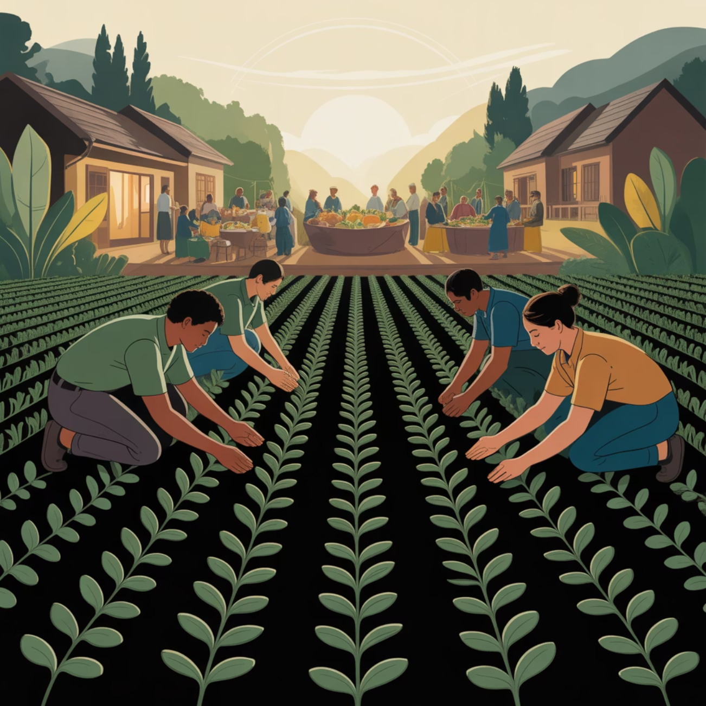

Food Security as Peace Infrastructure
The Stockholm International Peace Research Institute emphasizes that while conflict exacerbates hunger, addressing food security remains crucial for preventing conflict recurrence, particularly within fragile settings. Ethiopia's experience highlights food security as the fundamental divide capable of reigniting historical grievances among populations recovering from conflict.
Critical Link: Food security serves as essential peace infrastructure – its absence can destabilize even the most carefully negotiated peace agreements.
This aligns precisely with Dependency Theory's core assertion about global structural inequalities, where control over food and agricultural inputs resides in the global "core," constraining "periphery" states' autonomy to secure peace on their own terms. The Ethiopian case demonstrates how external food dependencies can undermine domestic peacebuilding processes and state capacity for conflict prevention.

Slide 15
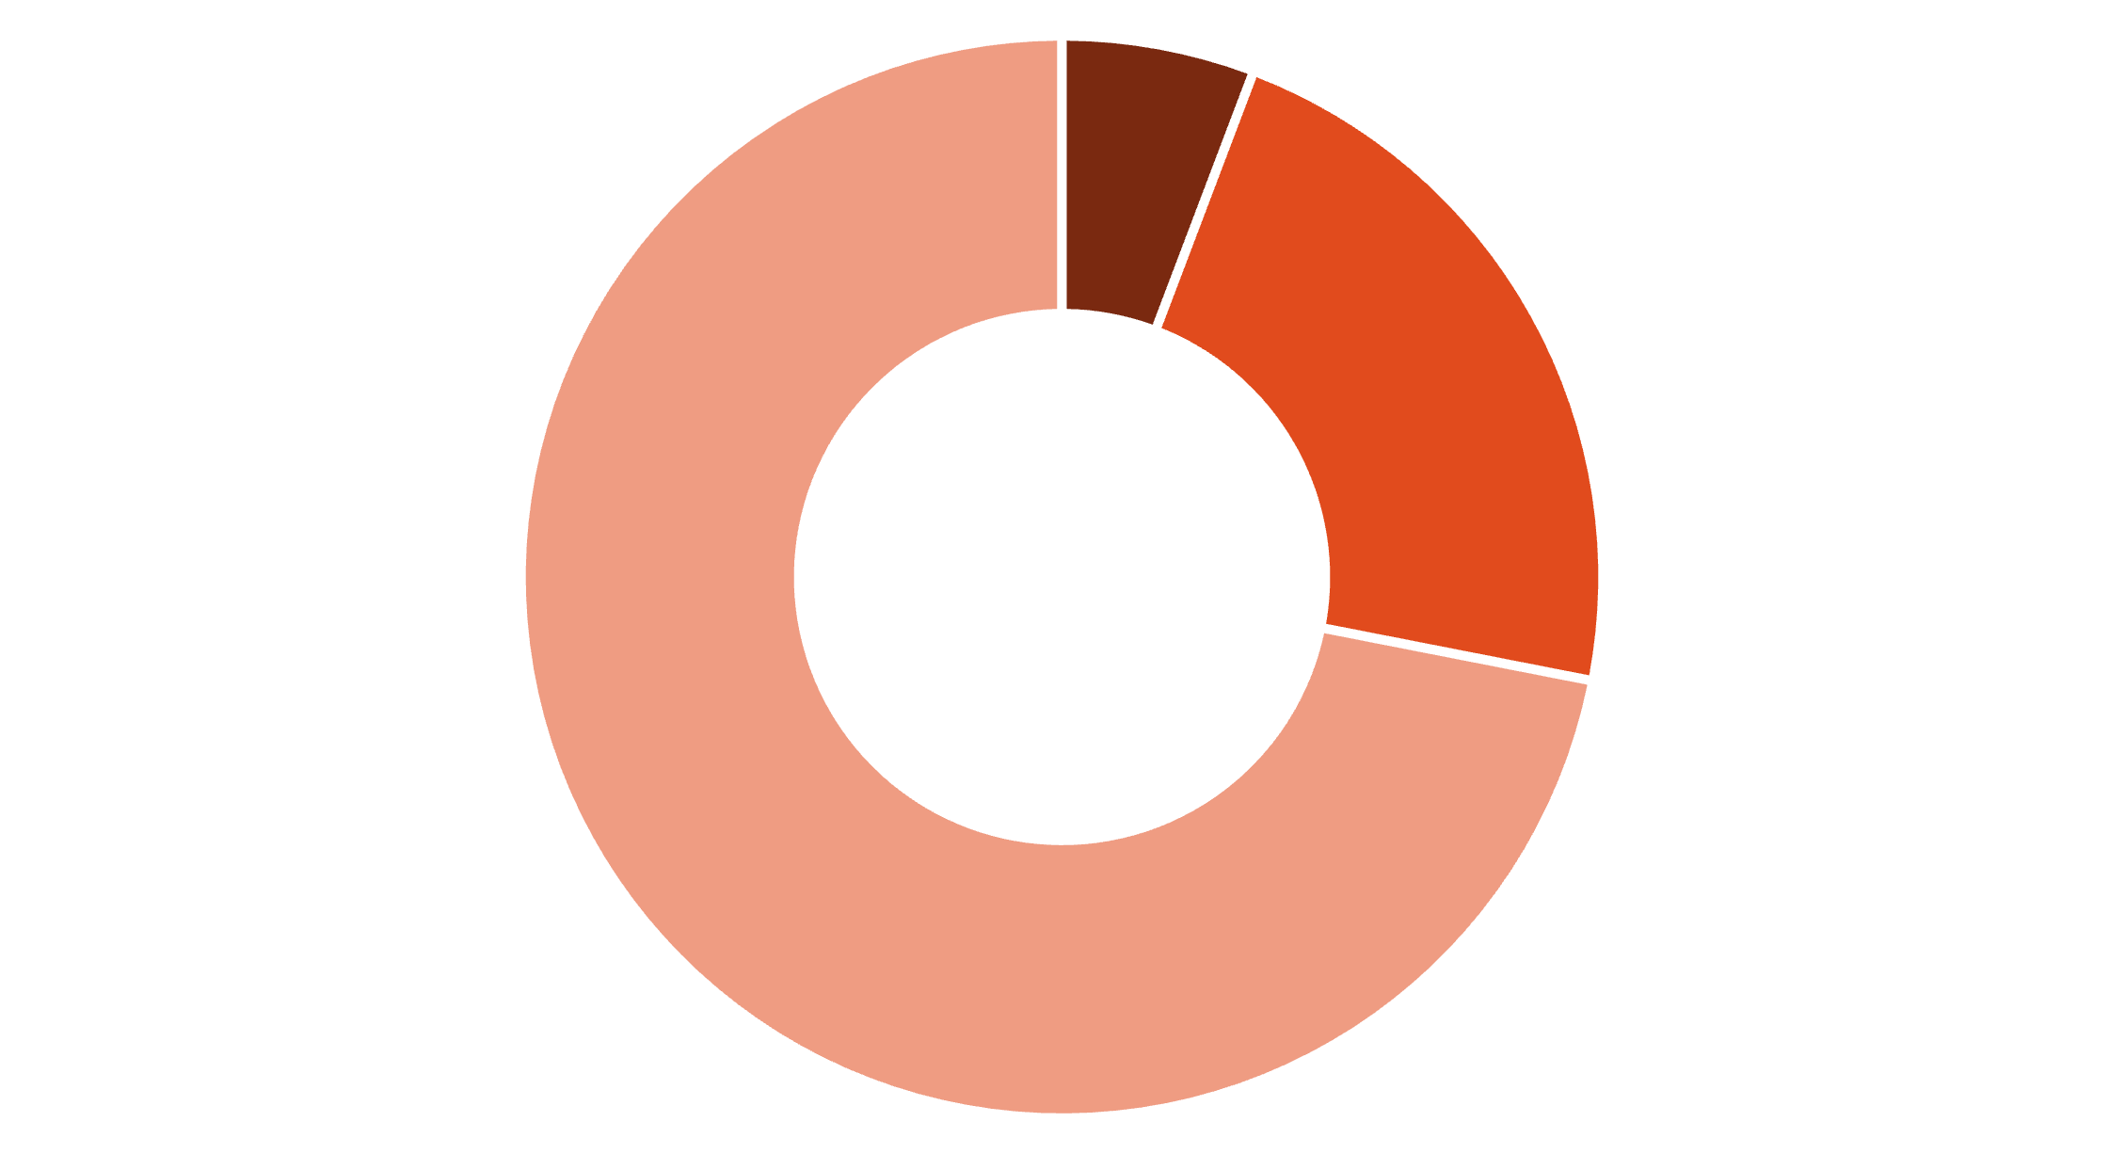
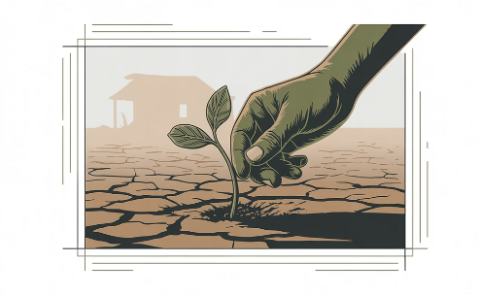
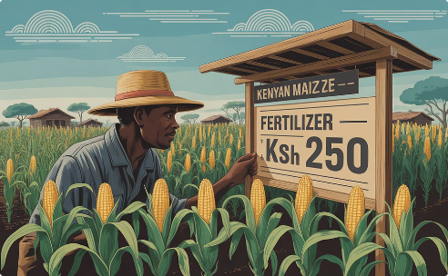
Regional Dependency Patterns
Over 70% Dependent
50-70% Dependent
Less than 50% Dependent
Before the war, more than half the wheat imported by 15 COMESA states originated from Russia and Ukraine. Countries like Eritrea, Sudan, and Djibouti exceeded 70% dependency levels, creating dangerous vulnerability concentrations across the region when combined with local fragilities.
Somalia Crisis
Kenya's Challenge
Excessive Black Sea wheat dependence coincided with prolonged drought, creating one of 2022-2023's most severe humanitarian crises
Despite lower Russia-Ukraine dependency, rising fertilizer costs hindered maize production and raised food price concerns

Slide 16




Regional Vulnerability Amplification
These case studies confirm this study's core finding: geopolitical shocks can dramatically amplify chronic vulnerabilities within globalized food systems, especially in states simultaneously managing ongoing conflicts, climate hazards, or political instability.
1
Ethiopia's Experience
2
Regional Pattern
3
Continental Challenge
4
Global System Vulnerability
Through Dependency Theory's lens, this represents structural unevenness in global economic relationships, where peripheral economies remain more susceptible to crises originating in core states. Ethiopia's experience exemplifies a continent-wide challenge requiring coordinated responses across multiple governance levels.
The evidence demonstrates how seemingly distant geopolitical events can cascade through interconnected food systems to destabilize regions already facing complex development and security challenges.

Slide 17




Strategic Policy Recommendations
Climate-Resilient Agriculture
Regional Grain Reserves
Develop drought-tolerant seed varieties for wheat and maize production. Promote improved farming practices including irrigation systems in key agricultural zones
Establish strategic buffer stocks within COMESA and EAC frameworks to cushion supply disruptions and enable rapid response capabilities
Continental Trade Integration
Leverage AfCFTA to reduce dependence on non-African suppliers through enhanced intra-African agricultural trade and reduced tariff barriers
The primary policy recommendations address Ethiopia's excessive reliance on imported grain and fertilizers, which creates dangerous exposure to global geopolitical shocks. Climate-resilient agriculture represents the most critical first step toward achieving community-level food sovereignty, while regional cooperation mechanisms can provide essential backup systems during external supply disruptions.

Slide 18




Implementation Framework
Diversification Strategy
Ethiopia must systematically diversify critical import sources to reduce geopolitical risk. This includes deepening commitments to import grain from suppliers like India, Argentina, and Australia, while establishing new partnerships for fertilizer supplies from Morocco and other African states.
Trade Diversification
Multiple supplier relationships reduce single-source dependency risks
Strategic Reserves
Bilateral agreements with reliable trading partners ensure crisis supply continuity
Early Warning Systems
Enhanced monitoring with FAO, WFP, and AfDB for integrated vulnerability assessment
Peacebuilding Integration
Food security must be situated within peacebuilding frameworks given the rapid co-existence of food insecurity and conflict. Enhanced efforts should include agricultural recovery and resilience as core components in instability prevention policies.
Combined, these recommendations would address Ethiopia's 'weaponized dependency trilemma' by focusing on domestic agricultural expansion, regional solidarity linkages, trade diversification, and conflict-sensitive food policy. Together, they offer pathways not only to food security but also to sustainable peace and economic resilience amid global event shocks.

Slide 19
Conclusion: Breaking the Dependency Cycle
This investigation demonstrates that the Russia-Ukraine war has significantly increased food insecurity and economic vulnerability in Ethiopia by undermining vital supply chains for wheat, sunflower oil, and fertilizers upon which the country traditionally depends. These external shocks compounded ongoing challenges including the Tigray conflict, climate-driven agricultural stress, and persistent rural poverty.
Weaponized Dependencies
Food-Peace Nexus
National Security Issue
Structural reliance on external commodities creates strategic vulnerabilities that imperil economic progress and peacebuilding
Food insecurity in fragile contexts represents both humanitarian crisis and potential catalyst for social unrest and peace process erosion
Food systems constitute critical components of national security and conflict prevention strategies
The concept of "weaponized dependency," drawn from Dependency Theory, illuminates how reliance on essential commodities sourced beyond national borders can be readily transformed into strategic vulnerabilities that threaten both economic development and sustainable peace. Food insecurity in fragile contexts like Ethiopia transcends humanitarian concerns to become a potential catalyst for social unrest, displacement, and fragile peace process erosion.

Slide 20


A Coalition for Resilience
Addressing weaponized dependencies requires coordinated action between nation-states, regions, and continents. As Ethiopia recovers from the dual shocks of internal conflict and global supply disruptions, its leaders face a transformative opportunity facilitated by agricultural modernization, regional cooperation, and strategic trade diversification.
Lessons from Ethiopia's experience hold significant value for other African countries, demonstrating the critical importance of building more resilient, self-reliant, and peace-supportive economies. The path forward requires acknowledging food security as fundamental infrastructure for both national development and continental stability.
Continental Unity
Regional Cooperation
Economic Resilience
Sustainable Peace
Food Sovereignty
The End! Thank You

