Slide 1

COMESA’s 30 Year Journey: Strengthening Trade and Investment for Regional Resilience and Strategic Growth
Beru Lilako
Trade and Economic Policy Specialist
October 1st-3rd 2025, Nairobi

Slide 2
“This milestone signifies COMESA’s relevance, endurance, and commitment to fostering the regional integration agenda to contribute towards the development of the Africa we want.”
Mutale Nalumango, Vice President Of Zambia

Slide 3
Content
    Introduction to COMESA
    Milestones and Achievements
    Strengthening Trade and Investment
    Building Regional Resilience
    Strategic Growth Initiatives
    Partnerships and Collaboration
    Future Outlook and Challenges

Slide 4
Introduction to COMESA

Slide 5
Overview of COMESA
  COMESA is a regional economic community comprising 21 member states in Eastern and Southern Africa.
  Established in December 1994, replacing the Preferential Trade Area (PTA) from the early 1980s.
  Major objective: To form a large economic and trading unit to overcome trade barriers among member states.
  Geographical coverage: about 12 million square kilometers with a population exceeding 490 million.
  Key institutions include the COMESA Authority (Heads of State), Council of Ministers, COMESA Court of Justice, and Secretariat.
  COMESA supports private sector institutions such as the Trade and Development Bank, COMESA Clearing House, and COMESA Competition Commission.
  Focus areas include trade facilitation, customs union, investment promotion, transport, communication, energy, agriculture, and technology.

Slide 6
Historical Context and Evolution (over 30 years)
  Concept roots trace back to the mid-1960s with early regional economic integration ideas.
  1965: UN Economic Commission for Africa convened a meeting recommending an East and Central African Economic Community.
  1978: Agreement to create a sub-regional Preferential Trade Area (PTA) as a first step toward a common market.
  1981: PTA officially established.
  1994: COMESA formed to replace PTA, aiming for deeper integration.
  2000: Launch of the COMESA Free Trade Area with initial member states.
  2009: Customs Union launched among COMESA members.
  Recent years: Progress on eliminating tariff and non-tariff barriers and expanding free trade coverage.

Slide 7
Vision and Mission of COMESA
  Vision: To be a fully integrated, internationally competitive regional economic community with high living standards for its people and to eventually merge into the African Economic Community.
  Mission: Achieve sustainable economic and social progress through increased cooperation and integration in trade, customs, monetary affairs, transport, communication, technology, industry, energy, agriculture, environment, and gender equality.
  COMESA aims to promote peace, security, and stability to enhance economic development in the region.
  The organization seeks to foster a conducive environment for domestic and foreign investment and research development.

Slide 8
Milestones and Achievements
  Intra-COMESA trade has steadily increased, reaching approximately $14 billion in recent years.
  The combined GDP of COMESA member states grew from about $90 billion in 1994 to $1.13 trillion in 2024, representing roughly one-third of Africa's total GDP.
  Notable trade growth occurred with expansion in exports and imports among member states and increased cooperation in trade liberalization.
  COMESA developed innovative trade facilitation tools such as the regional customs guarantee scheme and the yellow card system, setting benchmarks for trade facilitation across Africa.
  Membership expanded from initial fewer states to 21 member countries, fostering deeper regional economic integration in Eastern and Southern Africa.
  The Customs Union launched in 2009 further encouraged tariff elimination and harmonization of customs procedures among members.
  COMESA’s focus includes promoting transport, communication, and infrastructure improvements to boost regional trade connectivity and reduce non-tariff barriers.
  The Secretariat and partner institutions continuously support capacity building, policy coordination, and investment promotion in the region.

Slide 9
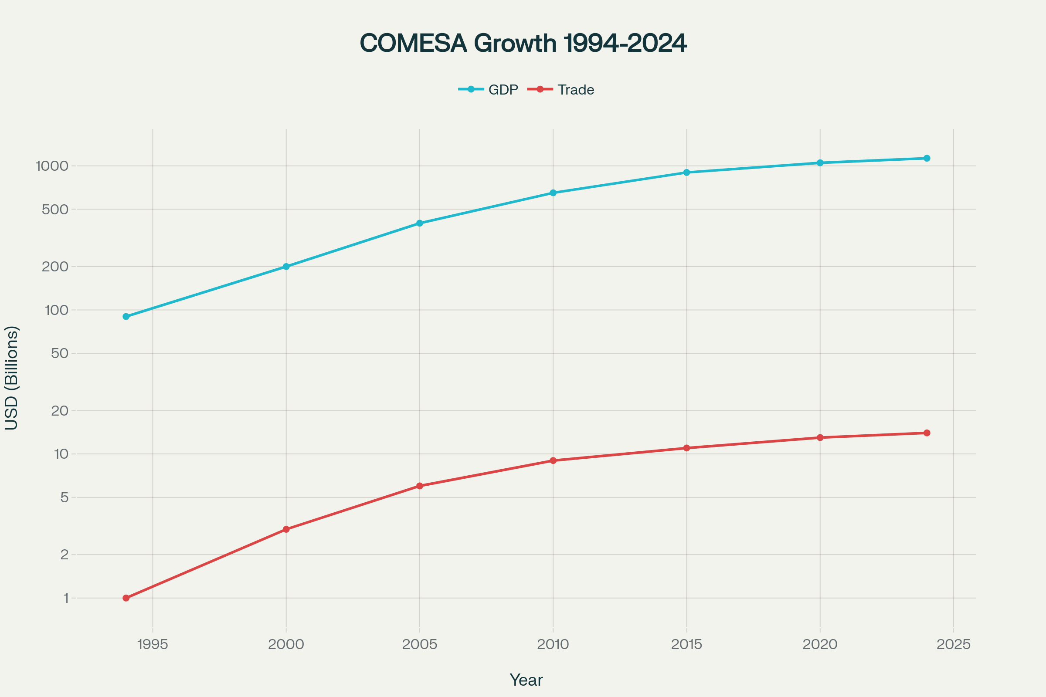
COMESA 30-year combined GDP and intra-COMESA trade growth (1994-2024)
The line graph shows the combined GDP growth of COMESA member states, expanding from $90 billion in 1994 to $1.13 trillion in 2024. It also displays the steady increase in intra-COMESA trade reaching $14 billion by 2024.

Slide 10
Strengthening Trade and Investment

Slide 11
Trade Facilitation Programs and Policy Harmonization
  Implementation of the Regional Customs Transit Guarantee Scheme and the Yellow Card system to facilitate smoother customs procedures and regional transit security.
  Development of the COMESA Customs Union since 2009, including harmonization of customs laws, common external tariffs, and adoption of a regional customs document.
  Simplified Trade Regime (STR) launched in 2010 to formalize and ease cross-border small-scale trade.
  Removal of non-tariff barriers like import licenses, foreign exchange restrictions, and roadblocks; streamlining border formalities with "one stop border posts."
  Programs to improve transport and communication infrastructure to support regional trade connectivity.
  Harmonized road transit charges for heavy goods vehicles among member states to facilitate road transport.

Slide 12
Establishment and Benefits of the Free Trade Area (FTA)
  COMESA Free Trade Area launched in 2000 to promote duty-free movement of goods produced within member states.
  FTA serves as a foundational step towards the Customs Union and deeper economic integration.
  Enables increased market access, larger regional market, reduction of tariffs, and enhanced competitiveness of member state goods.
  Facilitates a wider choice of goods, faster clearance, and lower production costs for regional businesses.
  Progressed toward a tripartite FTA with East African Community and Southern African Development Community to create Africa's largest FTA.

Slide 13
Investment Promotion Initiatives and Favorable Environments
  Adoption of the COMESA Common Investment Area (CCIA) Agreement in 2007 to harmonize investment policies and create a stable investment climate.
  Efforts to expand bilateral Avoidance of Double Taxation Agreements, promote investor protection, and arbitration mechanisms.
  Capacity building for national investment agencies and simplification of company registration processes.
  Promotion of regional monetary cooperation and investment facilitation to attract cross-border investors.

Slide 14
Private Sector Engagement and Role
  Support for development of private sector institutions including trade associations, chambers of commerce, and arbitration centers.
  Encouragement of private sector participation in regional integration activities and policy formulation.
  Facilitation of business information dissemination and trade intelligence to enhance private sector competitiveness.
  Capacity building programs targeting small and medium enterprises (SMEs), especially under the Simplified Trade Regime focusing on informal and small-scale traders.

Slide 15
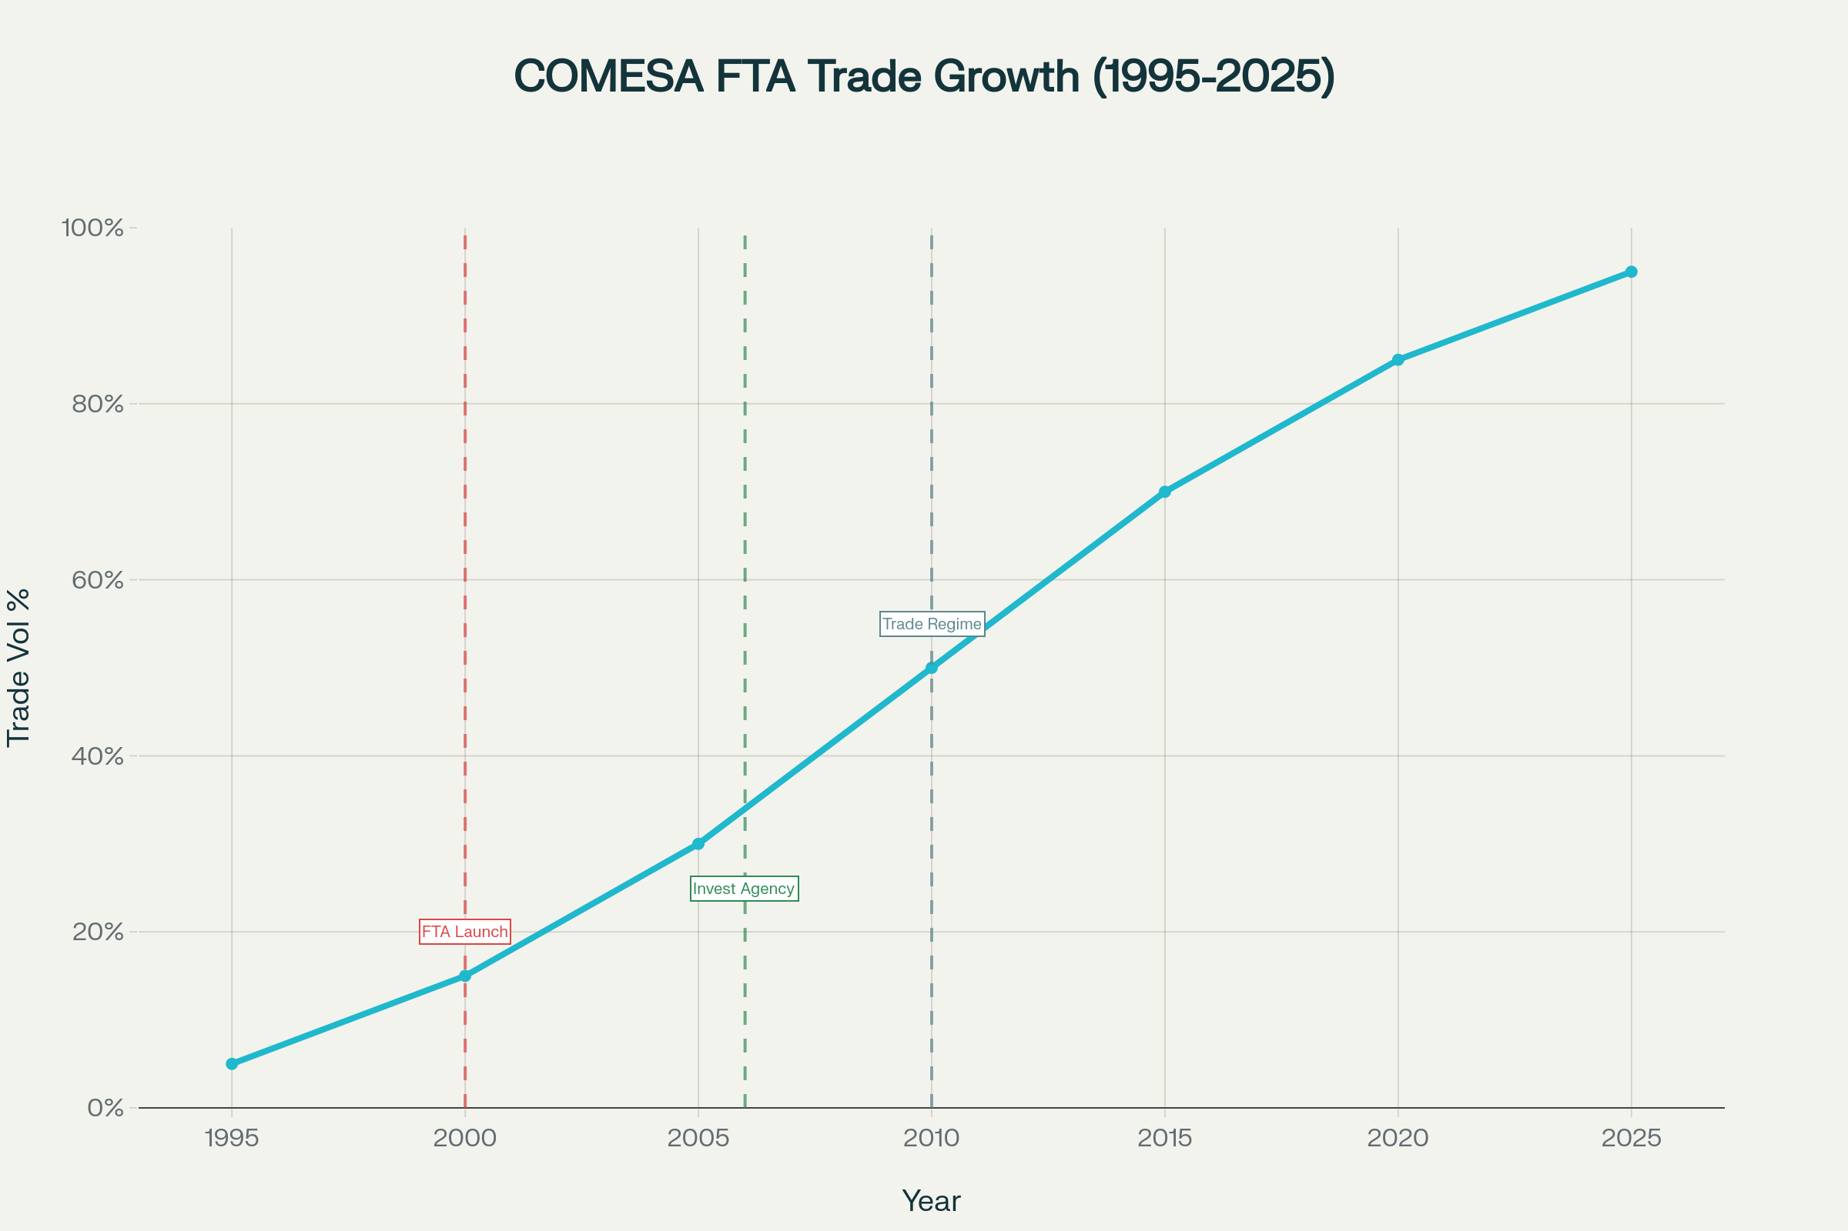
COMESA 30-year growth trends: Trade Facilitation and Policy Harmonization, FTA Benefits, Investment Promotion, Private Sector Engagement
Reflection on COMESA’s milestones like the FTA launch in 2000, the Simplified Trade Regime introduction in 2010, the Regional Investment Agency launch in 2006, and ongoing initiatives to digitalize trade and strengthen private sector advocacy and participation.

Slide 16
Building Regional Resilience

Slide 17
Strategies for Economic Resilience
  Adoption of a developmental regional integration approach emphasizing market integration, industrialization, and infrastructure development.
  Focus on economic diversification, particularly manufacturing and value addition, to reduce vulnerability to commodity price shocks.
  Promotion of trade as a key tool for economic recovery and resilience, including expanding trading opportunities with emerging markets.
  Strategies to enhance regional supply chain connectivity to mitigate external shocks like COVID-19 disruptions.
  Emphasis on inclusive growth by focusing on gender and social integration, youth empowerment, and innovation.
  Continuous improvement in regional transport corridors and communication networks to support economic resilience and competitiveness.

Slide 18
Debt Management and Fiscal Consolidation
  Efforts to promote fiscal discipline and sound macroeconomic policies among member states.
  Support for structural reforms aimed at improving public financial management and reducing debt vulnerabilities.
  Coordination of monetary and fiscal policies to foster stability and sustainable economic growth within the region.
  Advocacy for debt relief and restructuring initiatives to ease debt burdens and ensure sustainable financing for development.

Slide 19
Economic Diversification
  Encouragement of productive integration to build industrial capacities and diversify economies beyond traditional sectors.
  Support for agriculture modernization and agro-processing industries to add value locally.
  Investment promotion in non-traditional sectors to create new sources of growth and employment.
  Collaboration with development partners to mobilize resources for industrial and technological development initiatives.

Slide 20
Role of Regional Cooperation in Facing Economic Shocks
  Strengthened regional coordination mechanisms to respond collectively to economic crises such as the COVID-19 pandemic.
  Utilization of the COMESA platform for policy dialogue, sharing best practices, and joint problem-solving among member states.
  Implementation of regional safety nets and contingency plans to mitigate shocks to trade and financial flows.
  Advocacy for deeper regional economic integration as a buffer against global economic volatility.
  Promotion of peace and security as prerequisites for stable economic environments and sustained growth.

Slide 21
Strategic Growth Initiatives

Slide 22
Industrialization and Value Addition
  Promotion of agro-industrial parks, including a joint agro-industrial park between Zambia and Zimbabwe to boost intra-regional trade and manufacturing.
  Focus on value addition in agriculture and minerals beneficiation to reduce dependence on raw exports and increase regional industrial growth.
  Adoption of the COMESA Industrial Strategy emphasizing environment-friendly, diversified industrial growth based on innovation and manufacturing.
  Agriculture and agro-processing contribute significantly to COMESA’s GDP (32%) and employment, highlighting their role in industrialization.
  Development of policies and frameworks supporting special economic zones (SEZs) and industrial parks to attract investment and foster regional collaboration.

Slide 23
Infrastructure Development (Energy, Transport, ICT)
  Significant investments in regional transport corridors and energy infrastructure to improve connectivity and support industrial activities.
  Emphasis on developing sustainable and green energy solutions to power industries and rural areas.
  Initiatives to enhance information and communication technology (ICT) infrastructure to facilitate trade, e-commerce, and digital services.
  Collaboration with development partners for infrastructure financing and technical support.

Slide 24
Enhancing Regional Value Chains and Manufacturing Diversification
  Strengthening regional value chains in key sectors such as textiles, leather, pharmaceuticals, chemicals, agro-processing, and mineral beneficiation.
  Support for MSMEs to improve quality standards, industrial linkages, and cluster development at the regional level.
  Encouraging local content policies and investment incentives to boost manufacturing and job creation.
  Integration into continental initiatives like the African Continental Free Trade Area (AfCFTA) to expand markets and global competitiveness.
  Promotion of private sector engagement in developing value chains and manufacturing diversification.

Slide 25
Partnerships and Collaboration

Slide 26
Coordination with Other RECs and the African Union (AU)
  COMESA is one of the eight AU-recognized Regional Economic Communities (RECs) considered building blocks for the African Economic Community (AEC).
  Works closely with other RECs like the East African Community (EAC) and Southern African Development Community (SADC) to promote continental integration, including through the Tripartite Free Trade Area (TFTA).
  Engages in AU-led continental initiatives to harmonize policies, coordinate programs, and facilitate economic integration towards the AEC by 2028.
  Collaborates on common external tariff structures and trade facilitation measures to avoid duplication and enhance coherence among RECs.
  Supports AU's goals of peace, security, sustainable development, and industrialization as part of regional integration.
  Efforts to overcome historical competition and duplication with SADC by focusing on complementary roles and joint development projects.

Slide 27
Engagement with Development Partners and International Organizations
  Receives technical and financial support from multilaterals such as the African Development Bank (AfDB), World Bank, IMF, and UN agencies for capacity building, infrastructure, and trade facilitation.
  Works with bilateral partners including the European Union, United States, and China to mobilize resources and implement regional development programs.
  Engages with global trade bodies like WTO for trade policy alignment and dispute resolution mechanisms.
  Partnerships emphasize strengthening institutional capacity, policy harmonization, climate-smart agriculture, digital transformation, and investment promotion.
  Active participation in global forums to advocate regional interests, promote sustainable development, and enhance cooperation on cross-border challenges.
  Development partner collaboration enables COMESA to implement large-scale infrastructure projects and integration initiatives critical for economic growth.

Slide 28
Future Outlook and Challenges

Slide 29
Preparing for Sustainable Development and Climate Resilience
  Implementation of the Programme on Climate Change Adaptation and Mitigation in collaboration with EAC and SADC to increase investments in climate-resilient and carbon-efficient agriculture and energy.
  Support for member states’ Nationally Determined Contributions (NDCs) under the Paris Agreement, promoting low-carbon, resource-efficient, and socially inclusive economies.
  Promotion of climate-smart agriculture practices, expanding irrigation, removing trade barriers, and improving infrastructure to enhance agricultural productivity and resilience.
  Partnership with organizations like IISD for sustainable agriculture, responsible investments, and climate change support.
  Emphasis on green growth strategies, such as Zambia’s National Green Growth Strategy supported by COMESA for sustainable economic development.
  Ongoing efforts to align COMESA's medium-term strategies with the AU Agenda 2063 and the UN Sustainable Development Goals (SDGs).

Slide 30
Planned Initiatives for Trade and Investment Strengthening
  Continued focus on eliminating barriers to trade and promoting factor mobility (goods, services, capital, people) under the Medium-Term Strategic Plan 2021-2025.
  Expansion of free trade, customs union deepening, and efforts towards harmonizing regional trade policies and standards.
  Enhancing productive integration to build regional value chains, industrial capacities, and competitiveness.
  Fostering private sector participation and innovation, with targeted support for SMEs and youth empowerment.
  Strengthening physical infrastructure connectivity to reduce business costs and enhance market access.
  Mobilization of resources through partnerships with development partners and investors to support integration projects.

Slide 31
Vision for Next Phases of Regional Integration and Economic Growth
  Aspires to full regional integration characterized by a single market with seamless free movement of goods, services, capital, and people.
  Integrating digital transformation and technology-driven growth to boost transparency, efficiency, and inclusivity in economic activities.
  Emphasis on sustainable industrialization that leverages natural and human resources responsibly.
  Deepening sectoral integration with a focus on agriculture, manufacturing, energy, and services.
  Commitment to gender and social integration, ensuring equitable growth opportunities, especially for women and youth.
  Leveraging the African Continental Free Trade Area (AfCFTA) for expanded markets and global competitiveness.
  Strengthening institutional capacity, accountability, risk management, and monitoring frameworks to ensure effective implementation of integration programs.

Slide 32
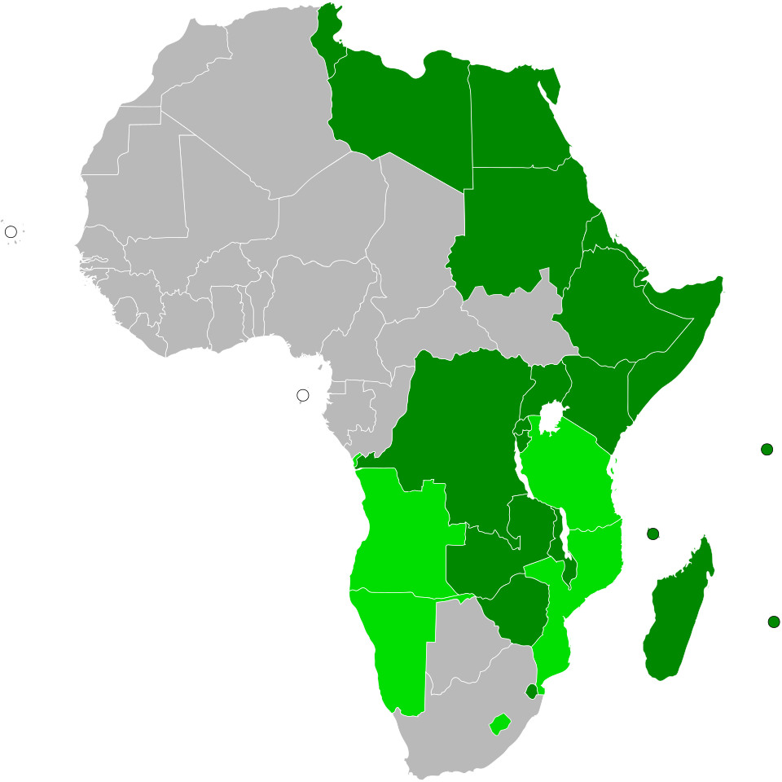
geelilako@gmail.com
Asante sana!

