Slide 1


ADVANCING CONFLICT PROGNOSIS: EMERGING EARLY WARNING APPROACHES IN AFRICA
Dr. Oita Etyang
Claudia Masah
Tatenda Mapiro
Nouran Abadi

Slide 2
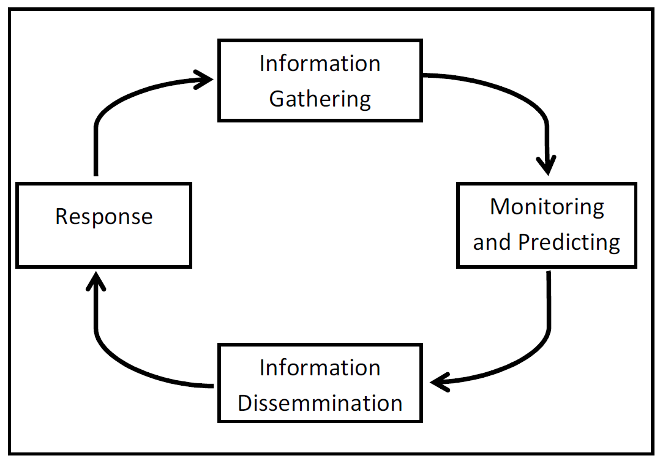
INTRODUCTION

Slide 3


Purpose of Early Warning Approaches
These approaches aid in preventing and mitigating conflict and humanitarian crises by monitoring tensions. They help anticiapte risks, reduce vulnerabilites, and support early response by providing timely, date-driven information to:
Governments
Regional Organisations
Grassroot Communities

Slide 4
THEORETICAL FRAMEWORK
Neo-liberal institutionalism
Holds that international cooperation between states is feasible and sustainable, and that such cooperation can reduce conflict and competition.
This approach views regional organizations as intermediary bodies crafted by states to deal with collective challenges.
The approach is concerned with how institutions shape bahaviour.
In the case of this study, the AU and RECs are perceived as institutions formed by self centred states to facilitate cooperation in conflict prevention.
The high level of interdependence in the global village provides the necessary grounds for synergies between and among organizations.

Slide 5
METHODOLOGY
Literature
Policy Documents
Normative and Policy Frameworks

Slide 6
Continental Early Warning System (AU)
It is a fundamental component of the African Peace and Security Architecture (APSA), which is designed to anticipate and prevent conflict across the continent
Established under Article 12 of the PSC Protocol, the CEWS comprises an observation and monitoring unit known as the "Situation Room“
CEWS is primarily tasked with data collection and analysis and maintains direct links to the observation and monitoring units of regional mechanisms for conflict prevention, management, and resolution.
It coordinates with RECs through technical meeting on Early Warning to review EW indicators

Slide 7
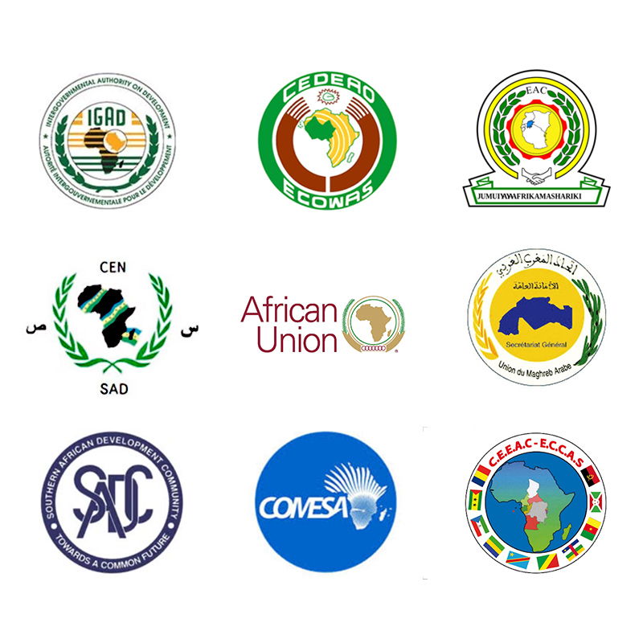
RECs in Africa

Slide 8
RECs | Early Warning System
ECOWAS | Early Warning and Response Network (ECOWARN)
IGAD | Conflict Early Warning and Response Mechanism (CEWARN)
EAC | East African Early Warning System (EACWARN)
ECCAS | Central Early Warning System (MARAC)
SADC | Regional/National Early Warning Centres (R/NEWCs)
COMESA | COMESA Early Warning Sytem (COMWARN)

Slide 9
RECs EWS ARCHITECTURE
RECs EWS | Architecture
ECOWARN | Information gathering and data analysis Utilises situation rooms and field monitors to enhance data collection and situational awareness.
IGAD | Encoding and exchanging information Coordinating with national-level Conflict Early Warning and Response Units (CEWERUs).
EACWARN | Has Regional EW Centers and National EW Units in each partner state to facilitate timely and accurate detection of conflicts and other threats before escalation into violence and crises. Information gathering, verification, analysis and dissemination information on potential areas that may pose threat to peace and security; Indicators are developed to facilitate the systematic collection and analysis of data for forecasting and risk assessment.

Slide 10
RECS EWS ARCHITECTURE
RECs EWS | Architecture
MARAC | Gathering and analysing data aimed at preventing, managing, and resolving conflicts. Structural organisation includes a central observation and analysis centre as well as zonal observation and analysis offices.
REWC/NEWC | Links with National Early Warning Systems across the SADC region, reinforcing regional cohesion in early warning initiatives Compilation of strategic assessments and data analysis at the regional level Dissemination of information on critical security threats, Formulation of recommendations to prevent, address, and manage such threats across the region

Slide 11
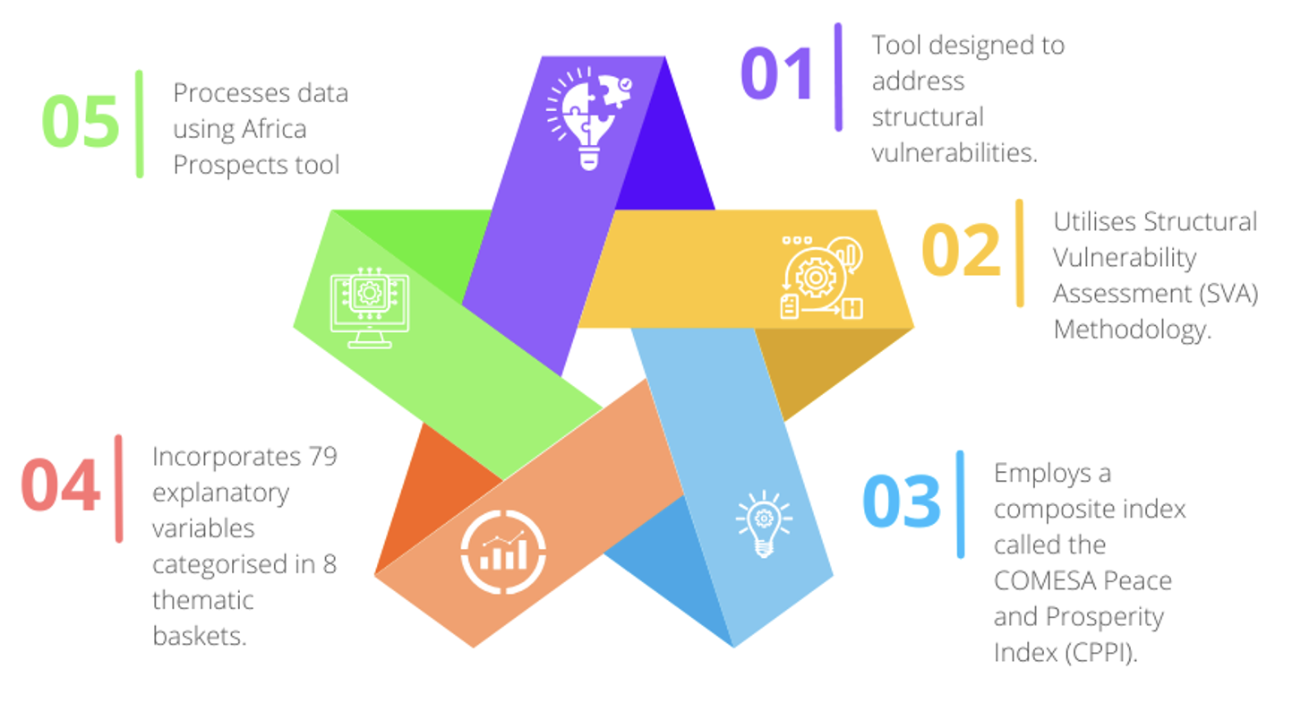
COMWARN

Slide 12

“Go to therapy—not to fix what's happening now, but to understand what happened before.”
THE EMERGING EARLY WARNING APPROACHES

Slide 13
COMWARN SVA & AU CSVRA: Why the emergence?
The two approaches focus and invest in structural prevention by carrying out a systemic diagnosis of long-term drivers of conflict in areas of governance and the socio-economic sphere. They focus on factors that lead to a rise in a country’s baseline vulnerability to instability and insecurity.
The need for early identification of emerging challenges
The need for data driven analysis to remove biases
The need to understand the past
The need to understand the relationship between the past and the future
The need for a country solution for country problems
The need to understand effects based on different categorization – age, economy, rural/urban

Slide 14
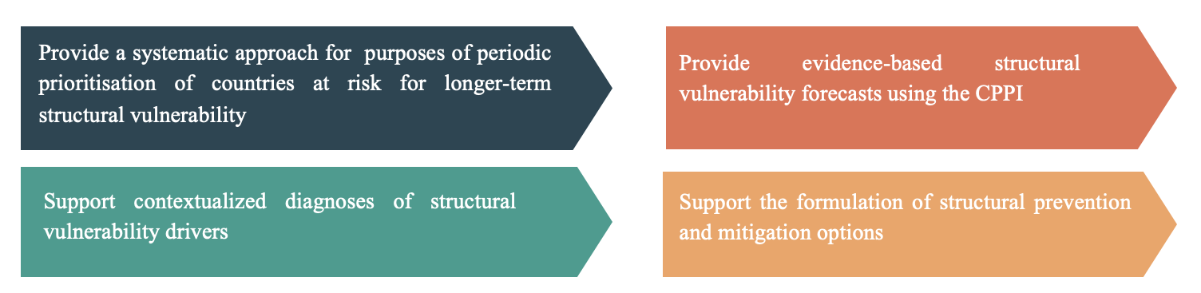
COMWARN SVA
COMESA Peace and Prosperity Index (CPPI); peace, health, wealth, and trade openness
The SVA is conducted annually to forecast countries’ level of vulnerability and serves as initial input for analytic investigation of underlying factors affecting peace and security. It seeks to:

Slide 15
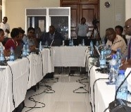
COMWARN SVA
Popularising the SVA methodology regionally has been conducted through:
Experience-sharing and peer learning
Training of Trainers’ Workshops (ToTs)
COMWARN News Highlights
Early Warning Reports
National Multistakeholder Consultations

Slide 16
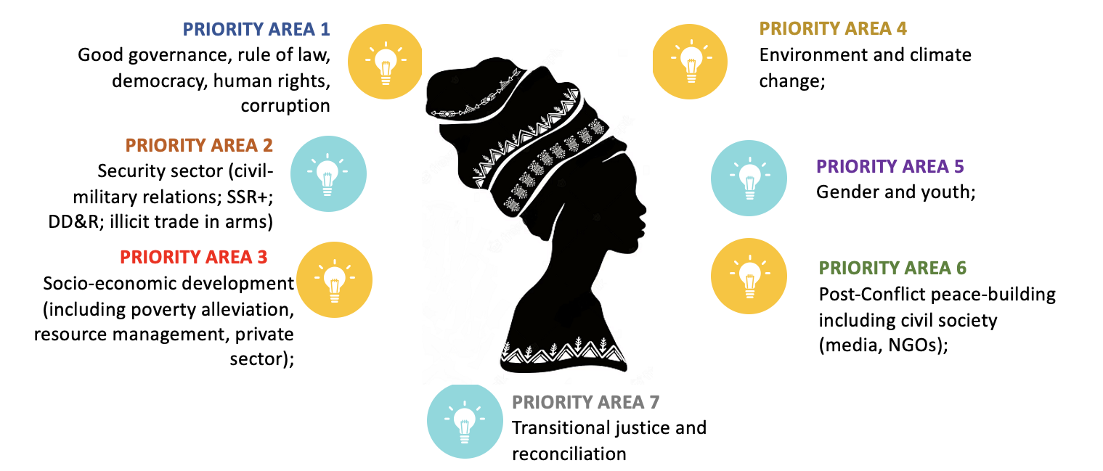
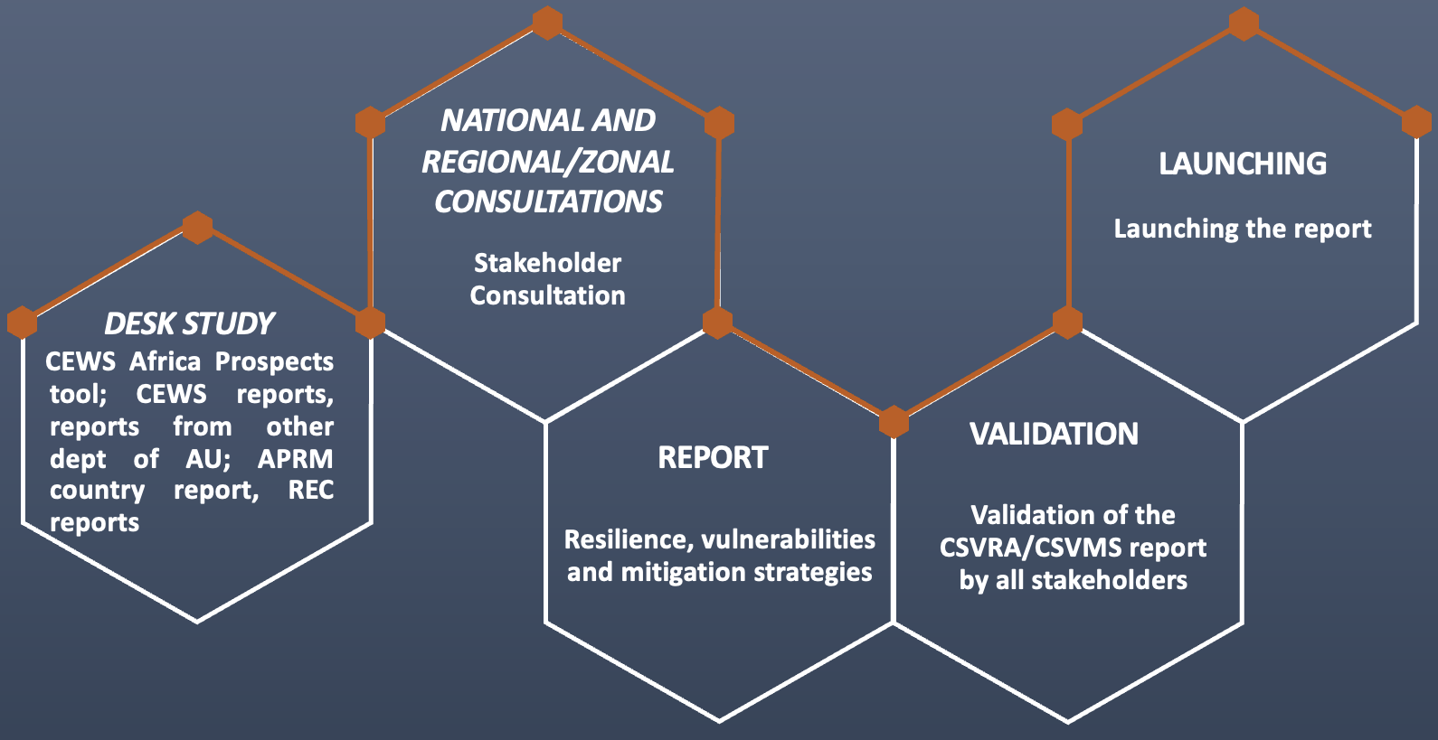
AU CONTINENTAL EARLY WARNING SYSTEM CSVRA
AU CEWS is noted as a requisite of the PSC Protocol as detailed in Article 12 (1), which states; “in order to facilitate the anticipation and prevention of conflicts, a Continental Early Warning System (CEWS) to be known as the Early Warning System shall be established.”
CEWS processes include the Country Structural Vulnerability and Resilience Assessment (CSVRA) and the Country Structural Vulnerability Mitigation Strategies (CSVMS) – two concepts that go hand in hand.
The CSVRA takes on a narrower national and subnational focus and identifies drivers of conflict and instability across numerous priority areas, as depicted in the graphic (top right).
The CSVRA process is voluntary, and its commencement is premised on a direct request from AU and RECs’ Member States.
The CSVRA allows for a country-specific narrative and explanatory analysis and serves as a report for developing an appropriate mitigation strategy – which focuses on targeted medium to long-term strategies to mitigate vulnerabilities and build resilience.
Numerous steps are included in the undertaking of the CSVRA process, as depicted in the graphic (bottom right).

Slide 17
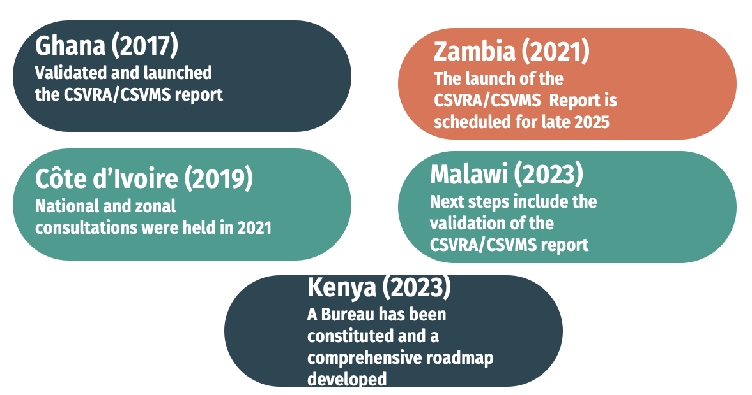
SVA and CSVRA In Motion
Several AU/COMESA Member States have volunteered to undergo the CSVRA process, namely;
This represents a growing regular-self-assessment culture among African countries, which aids in shifting away from RECs’ “firefighting” role to proactive prevention
Côte d’Ivoire
Zambia
Malawi

Slide 18
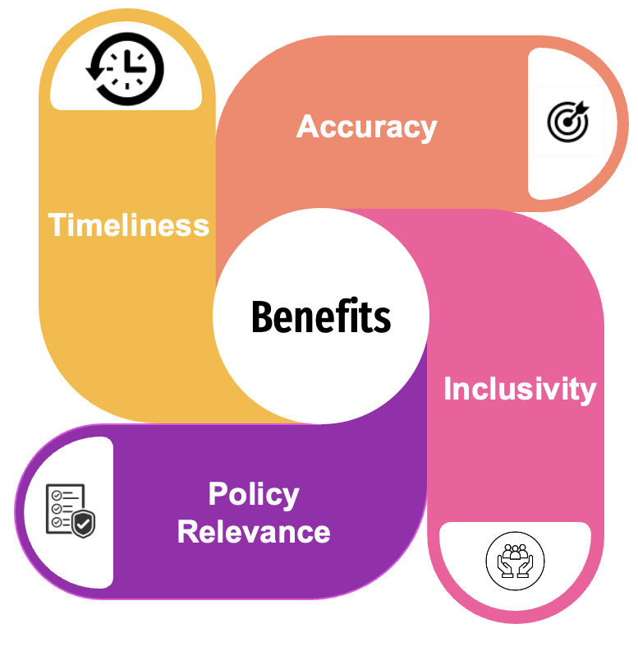
THE BENEFITS OF THE EMERGING EARLY WARNING APPROACHES
Benefits to States
Enhancement of understanding and robust analysis of both structural and proximate causes of conflict to facilitate timely, corresponding responses.
Attract technical and financial support from the AU and RECs/RMs for implementation of mitigation strategies.
Data-driven and theory informed.

